Slide 1

New Board Member Class

Slide 2

BerendsonAcademy.com
Notes:
Next we will share with you an overview NBM Class

Slide 3
Training Book from Berendson Academy
Committee Training Book
Committee Appendix – Forms and Charges
Could You Be Sued as a Co-op Board Member?
Annual Checklist

Slide 4

Agenda
Welcome
Your Journey to Cooperative Housing Excellence Begins Here!
New Board
Manual
The Fascinating World of Cooperatives.
Legal
Duties
Could You Be Sued as a Co-op
Board Member?
Yearly
Checklist
Maintain Compliance with
Legal Requirements

Slide 5
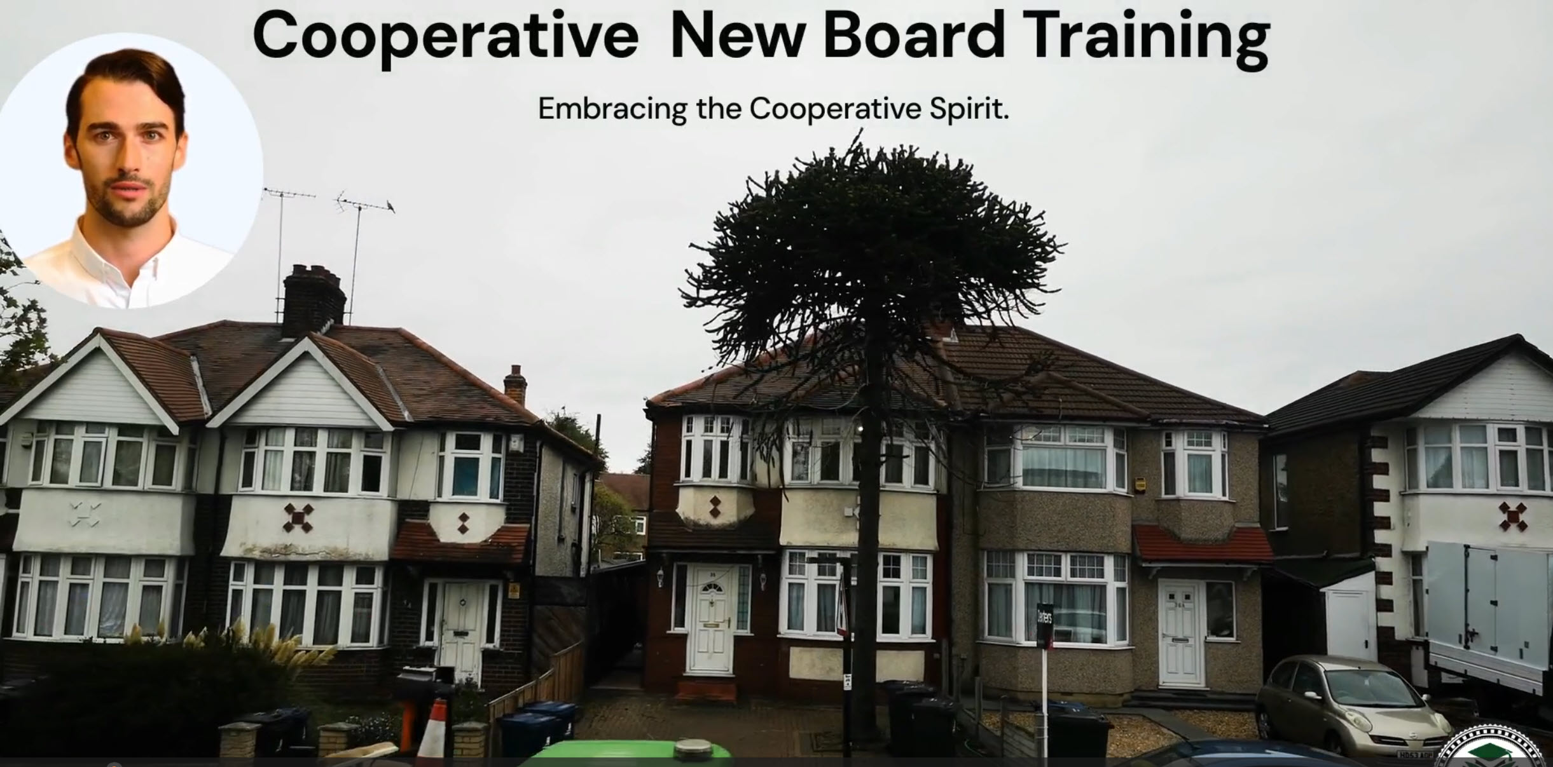

Slide 6
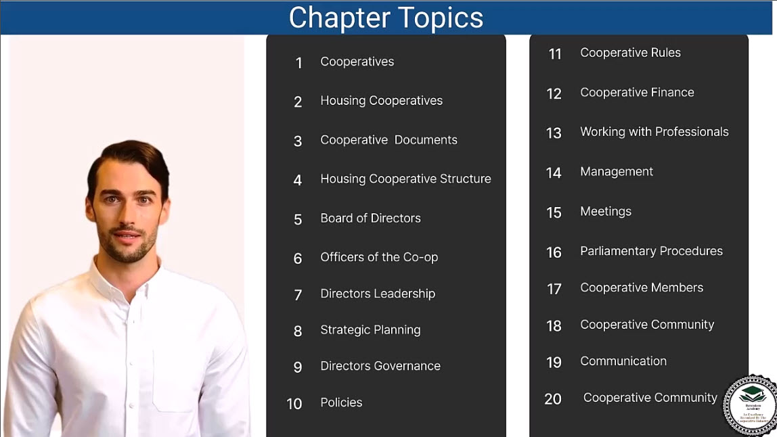
Notes:
Turn to page 4 of the new board member manual
Next is a video you can use for orientation or on your web sit on what a housing coop is

Slide 7


Slide 8
Chapter 1 – The Fascinating World of Cooperatives
Welcome to the vibrant world of cooperatives — a movement built on fairness, equality, and community empowerment
.As a new board member, you join a legacy of people helping people through shared ownership and democratic control.
Your journey begins with understanding the principles that make cooperatives unique and impactful.
Cooperatives aren’t just businesses — they are communities built on purpose and participation.

Slide 9
The Birth of Cooperatives: The Rochdale Story
Rochdale, England – 1844
28 weavers and artisans united to create the first cooperative store on Toad Lane.
Their mission: sell goods honestly, share profits fairly, and empower their community.
These pioneers gave birth to the Rochdale Principles, the cornerstone of today’s cooperatives.

Slide 10
The Birth of Cooperatives: The Rochdale Story
Original Principles:
Open Membership -
Democratic Control
Surplus Distribution -
Limited Interest on Capital
Political/Religious Neutrality - Cash Trading
Education for Members
Their courage and collaboration sparked a global movement.

Slide 11
The Modern Cooperative Spirit
Evolving with Time:
The Rochdale Principles inspired the International Cooperative Alliance (ICA), which modernized them in 1996.
Today’s cooperatives embrace:
Autonomy and independence
Cooperation among cooperatives
Concern for community
Global Impact:
From local housing co-ops to global brands like Land O’Lakes, the Rochdale vision endures.
Cooperatives empower millions worldwide through shared values and mutual success.

Slide 12
What Makes a Cooperative Unique
Core Traits:
    Member Ownership: Every member has a stake.
    Democratic Control: Every voice matters — one member, one vote.
    Mutual Benefit: Success is shared among members.
The 3 Pillars of Cooperative Identity:
User-Owner – Members own the cooperative.
User-Control – Members make the decisions.
User-Benefit – Members share the rewards.
These values transform a business model into a community movement.

Slide 13
Your Role as a Cooperative Leader
As a board member, you are a guardian of cooperative values and a voice for your members.
Embrace education, transparency, and collaboration in every decision.
Learn from history, lead with integrity, and advocate for continuous growth.
Reflect:
How will you champion fairness, inclusivity, and cooperation in your leadership role?
Together, we carry forward a 180-year legacy of community, courage, and shared success.

Slide 14
Introduction to Cooperatives:
Highlights the member-driven nature of cooperatives and their role in promoting community welfare.
Rochdale Principles:
Emphasizes the foundational principles established in 1844, including open membership, democratic control, profit sharing, and education.
Core Cooperative Attributes:
Focuses on member ownership, mutual benefits, and equitable decision-making that set cooperatives apart from traditional businesses.
Diversity of Cooperatives:
Describes various types such as consumer, worker, producer, and multi-stakeholder cooperatives, illustrating their versatility across sectors.
Guiding Principles:
Outlines the ICA’s essential principles that govern cooperatives, promoting autonomy, education, and community focus.
Role of Board Members:
Stresses the importance of board members and directors as guardians of the cooperative’s vision, fostering leadership and member advocacy.

Slide 15
Chapter 1 Cooperatives Quiz
When did the Rochdale Society of Equitable Pioneers open their store in Rochdale, England?
A) 1844
B) 1899
C) 1776
D) 1920
Which of the following is one of the original Rochdale Principles as outlined in 1844?
A) Profit Maximization
B) Limited Interest on Capital
C) Excessive Competition
D) Exclusive Membership
How did the Rochdale Principles evolve over time?
A) They remained unchanged since 1844.
B) They became more exclusive.
C) They adapted to changing societies and economies.
D) They were abandoned in the 20th century.

Slide 16
Chapter 1 Cooperatives Quiz
Which of the following is NOT one of the three fundamental principles that serve as the pillars of cooperatives?
A) Autonomy and Independence
B) Member Economic Participation
C) Profit Maximization
D) Democratic Member Control
Which type of cooperative is owned by the very people who purchase their goods or use their services?
A) Worker Cooperative
B) Purchasing Cooperative
C) Consumer Cooperative
D) Multi-Stakeholder Cooperative

Slide 17
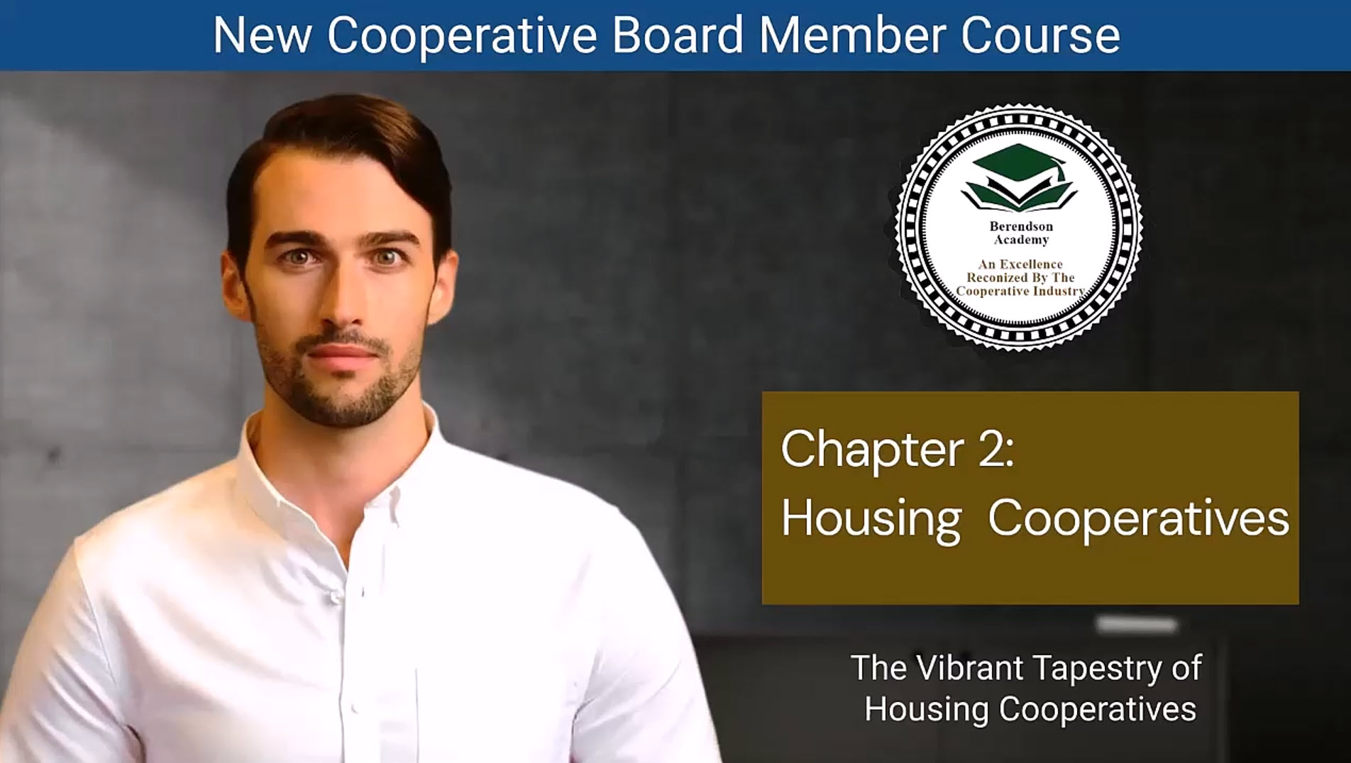

Slide 18
Chapter 2 – The Vibrant Tapestry of Housing Cooperatives
Cooperative housing has roots reaching back to ancient Babylon, where shared living began.
19th-century Europe sparked the modern cooperative housing movement, driven by reformers who sought fairness and affordability for workers.
The concept crossed the Atlantic, flourishing in U.S. cities like New York, Chicago, and Boston.
Despite wars and economic downturns, cooperative housing endured — adapting and thriving.
From ancient collaboration to modern innovation, cooperative housing reflects resilience and shared purpose.

Slide 19
The Many Faces of Cooperative Housing
Diverse Models Serving Diverse Needs:
Market-Rate Cooperatives – Member-owned, operating under real estate market values.
Limited-Equity Cooperatives – Keep homes affordable through resale limits.
Senior & Special Needs Co-ops – Supportive, accessible environments for specific populations.
Manufactured & Student Housing Co-ops – Affordable, community-centered living options.
Artist & Multi-Stakeholder Co-ops – Blending creativity and collaboration.
Each model tells a story of people joining together to meet shared needs.

Slide 20
The Heartbeat: Principles and Values
  Distinctive Ownership: Members share both the property and the purpose.
  Democratic Control: Every member has an equal voice in decision-making.
  Equality and Inclusiveness: Open to all; success built through participation.
  Adaptability & Balance: Blend of social responsibility and financial stability.
Core Values in Action:
  Economic empowerment
  Shared responsibility
  Community connection
Cooperative living transforms housing into a shared mission, not just a shared space.

Slide 21
Limited-Equity Cooperatives: Balancing Dreams & Affordability
  Designed to preserve long-term affordability while supporting ownership.
  Direct Equity Limits – Cap how much value a unit can gain.
  Income-Based Access – Ensure homes remain available to moderate-income families.
  Benefits: Stability, accessibility, and community strength.
  Challenges: Financing and limited personal equity growth.
  Limited-equity co-ops protect communities by keeping homes within reach for future generations.

Slide 22
The Benefits of Cooperative Living
  Economic & Social Advantages:
    Affordability: Lower living costs through shared ownership and tax benefits.
    Ownership Pride: Members invest in maintaining quality and safety.
    Influence & Autonomy: Direct voice in governance and decision-making.
    Community & Security: Stronger connections and shared responsibility.

Slide 23
The Benefits of Cooperative Living
  In Summary:
  Housing cooperatives nurture community, affordability, and empowerment.
  They stand as a vibrant, sustainable alternative to traditional housing.
  Cooperatives aren’t just homes — they are communities built on shared values and lasting stability.

Slide 24
1. Historical Development:
Cooperative housing has origins in ancient communal living and evolved significantly during the 19th century in response to poor housing conditions during industrialization, later expanding into the U.S.
2. Diversity of Models:
Various housing cooperative types exist, including market-rate, limited-equity, leasing cooperatives, and models catering to specific groups like seniors, students, and artists.
3. Core Principles:
Housing cooperatives emphasize democratic control, inclusiveness, and a personal investment in community well-being, evolving decision-making processes that prioritize member needs over profit.
4. Limited Equity Cooperatives:
These models balance affordability with homeownership aspirations by restricting equity appreciation to keep homes accessible while ensuring long-term community stability.
5. Benefits of Cooperative Living:
Cooperative housing fosters economic viability, pride of ownership, and collective influence, leading to lower living costs, enhanced community security, and strong inter-member bonds..
6. Modern Significance
Despite challenges, housing cooperatives continue to thrive, embodying values of affordability and community that address current housing demands and reshape living experiences.

Slide 25
Chapter 2 Housing coop Quiz
In which ancient civilization can the origins of cooperative living be traced back to?
A) Ancient Greece
B) Ancient Rome
C) Ancient Babylon
D) Ancient Egypt
When did the cooperative housing movement begin to take shape in late 19th-century Europe?
A) 15th century
B) 17th century
C) 19th century
D) 20th century
Which of the following is NOT a type of housing cooperative model discussed in the chapter?
A) Worker Housing Cooperatives
B) Limited-Equity Cooperatives
C) Senior Housing Cooperatives
D) Homeowners' Associations

Slide 26
Chapter 2 Housing coop Quiz
What is the fundamental idea that drives limited equity cooperatives?
A) Maximize individual profits
B) Ensure long-term affordability
C) Encourage speculative investment
D) Promote luxury living
What is one of the primary advantages of cooperative living mentioned in the chapter?
A) High financial costs
B) Lack of ownership pride
C) Lower living expenses
D) Limited autonomy

Slide 27
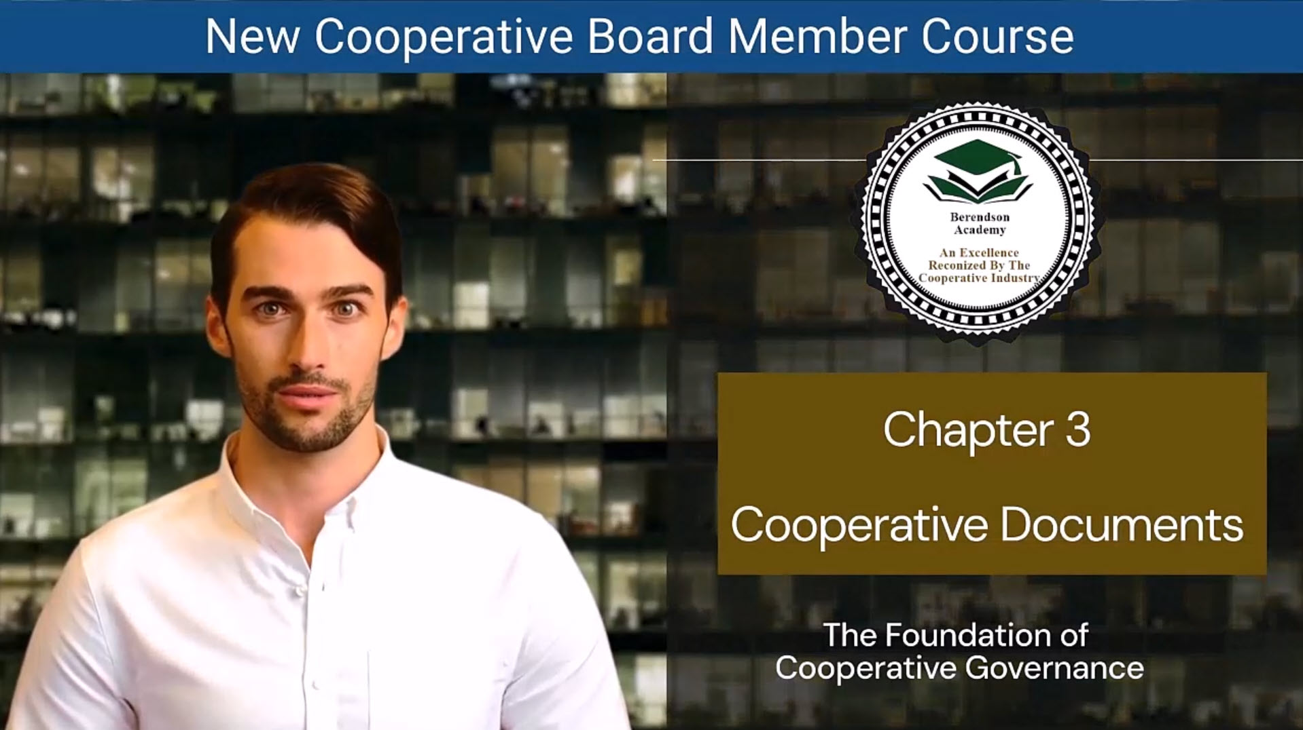

Slide 28
Chapter 3 – Cooperative Documents: The Foundation of Governance
Provide authority & legal framework for board and operations
Define rights, duties, and accountability for members and directors
Create transparent processes for decisions, compliance, and conflict resolution
Guide everyday actions so the community runs fairly, lawfully, and predictably
Strong documents = clear expectations = smoother governance.

Slide 29
Core Corporate Documents
Articles of Incorporation
  Establish legal identity, mission/purpose, powers
  Frame board composition & elections; connect co-op to state law
Bylaws
  Operating manual for internal governance
  Member rights/obligations, meeting rules, voting, amendments
  Policy repository; stable yet adaptable when changes are needed
Board Takeaway: Master Articles + Bylaws first—they anchor every other document.

Slide 30
Co-op ↔ Member Documents
Subscription Agreement (often for new/co-op formation)
  Signals member commitment; outlines expectations before joining
Occupancy Agreement / Proprietary Lease
  Sets mutual rights & responsibilities (use of unit, maintenance, conduct)
  Details procedures for issues, notices, remedies
Supporting Policies & Guides
  House rules, maintenance protocols, dispute processes, community participation
Clarity here builds trust, cohesion, and consistent member experience.

Slide 31
Co-op ↔ External Agencies
Mortgage/Loan Agreement
Terms, collateral, covenants—protects financial stability and lender trust
Regulatory Agreement
Ensures compliance; documents reporting & conflict-resolution pathways
Management Agreement & Plan
Defines scope, standards, metrics, and oversight of management services
Board Role: Monitor compliance milestones and performance metrics

Slide 32
Directing the Directors: Governance Toolset
Strategic Plan — Mission, priorities, resources, timelines (living roadmap)
Board Policy & Procedures Manual — Decision rules, delegations, ethics, annual calendars
Annual Budget — Aligns dollars with strategy; board review & approval
Committee Charters & Job Descriptions — Roles, scope, deliverables, boundaries
Mission Statement — North Star for decisions, culture, and accountability
Core Takeaway:
Documents turn values into action. When boards use them consistently—plan, budget, comply, report—the cooperative stays transparent, resilient, and member-centered.

Slide 33
1. Importance of Governing Documents:
Governing documents, including bylaws and articles of incorporation, are essential for defining the structure, rights, and responsibilities within a cooperative, ensuring legal compliance and continuity in governance.
2. Core Legal Documents
The Articles of Incorporation establish the cooperative's identity and purpose, while Bylaws serve as the operative rulebook guiding internal operations, member rights, and governance processes.
3. Member Relationship Documents
Key documents such as the Subscription Agreement and Occupancy Agreement outline the mutual rights and obligations of the cooperative and its members, ensuring a clear understanding of expectations.
4. Roles in Policy Development:
The board plays a central role in adopting and reviewing governance documents, and they must ensure policies align with the cooperative's mission and do not conflict with existing governing documents.
5. Regular Updates and Reviews:
Policies should be regularly reviewed and updated to remain relevant, reflecting changes in laws and community needs while ensuring they are easily accessible to all members.
6. Significance of Transparency and Accountability:
Maintaining clear and transparent documentation promotes trust within the community, ensuring that all members understand their rights and the cooperative’s operational guidelines.

Slide 34
Chapter 3 Cooperative Documents Quiz
What is the primary purpose of cooperative governing documents, such as Articles of Incorporation and Bylaws?
A) To provide entertainment for cooperative members
B) To create bureaucratic paperwork
C) To establish the cooperative's foundational structure and operations
D) To confuse members with legal jargon
Which document serves as a dynamic rulebook governing internal operations within a cooperative?
A) Articles of Incorporation
B) Mission Statement
C) Bylaws
D) Strategic Plan
What is the role of the Regulatory Agreement in a cooperative?
A) Establishing financial commitments
B) Guiding cooperative governance
C) Ensuring compliance with legal and ethical standards
D) Defining roles and responsibilities

Slide 35
Chapter 3 Cooperative Documents Quiz
Which document serves as a financial blueprint for a cooperative's interactions with lending institutions?
A) Bylaws
B) Mission Statement
C) Regulatory Agreement
D) Mortgage Agreement
What is the purpose of the Strategic Plan in a cooperative?
A) To confuse members with long-term goals
B) To serve as a financial budget
C) To provide a roadmap for the cooperative's future
D) To outline committee objectives and responsibilities

Slide 36
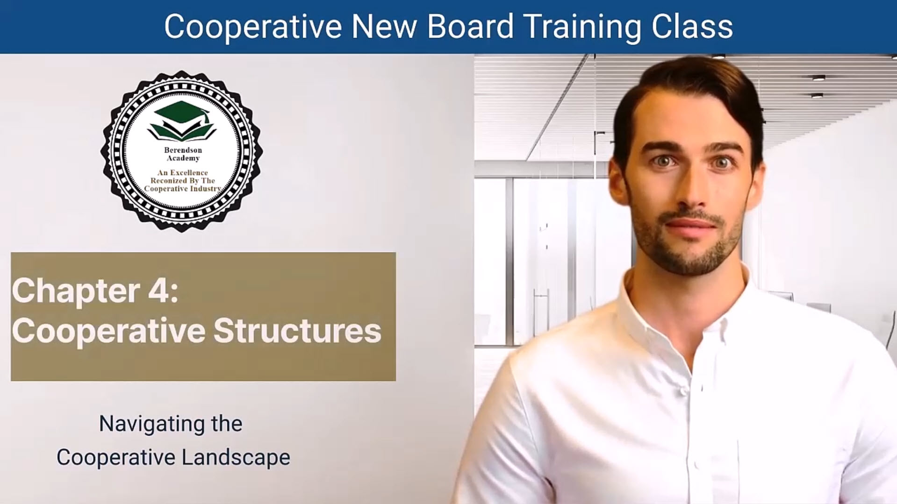

Slide 37
Chapter 4 – Cooperative Structure: Leading Through Governance
Cooperatives thrive on democratic structure and collective decision-making
The Board of Directors upholds bylaws, policies, and member trust
Leadership is rooted in service, transparency, and accountability
Understanding structure = understanding how your co-op truly works
Board service is both a privilege and a responsibility to the entire community.

Slide 38
Responsibilities of Directors
Uphold bylaws, policies, and cooperative values
Prepare for and attend meetings – participation is critical
Serve on committees and represent the board with one voice
Maintain confidentiality; avoid personal gain or conflicts
Promote education, fairness, and excellent member service
Committees and collaboration turn governance into action.

Slide 39
Legal and Ethical Obligations
Act as fiduciaries – serve the co-op’s best interests above your own
Disclose and manage conflicts of interest transparently
Maintain ethical credibility – no gifts, favors, or political use of position
Protect confidential information and follow attendance policies
Volunteer role – no personal compensation beyond approved reimbursements
Integrity builds the credibility your cooperative depends on.

Slide 40
Authority and Development
Board authority is collective, not individual
Participate in orientation, training, and ongoing development
Secure and maintain key organizational documents (digital + hard copy)
Evaluate performance – seek accountability and results
Plan for sustainability – diverse revenue, strong reputation, and adaptability
Well-trained, united boards sustain strong cooperatives.

Slide 41
Your Leadership Impact
You are a guardian of mission, ethics, and member trust
Practice transparency and fairness in every decision
Communicate clearly – craft your “elevator speech” about your co-op’s value
Lead with empathy, vision, and responsibility
Together, the board ensures ethical governance and long-term success
Effective leadership transforms cooperative principles into everyday practice

Slide 42
1. Central Role of the Board:
The Board of Directors is critical in shaping the cooperative's strategic direction and governance, ensuring effective management of the cooperative's operations.
2. Responsibilities of Directors
Board members have diverse responsibilities, including establishing the cooperative's vision, overseeing financial health, monitoring performance, and ensuring accountability to the members.
3. Director Qualities and Skills:
Successful directors must possess qualities such as adaptive leadership, strategic vision, conflict resolution skills, and financial knowledge, which are essential for navigating the unique challenges of cooperative management.
4. Legal Obligations
Directors must uphold fiduciary duties and adhere to legal standards, ensuring the cooperative operates ethically and in compliance with applicable laws.
5. Authority Structure:
Boards delegate operational authority to management while retaining oversight to ensure that decisions are made in the best interest of the cooperative and its members.
6. Succession Planning and Continuous Learning:
Boards should engage in ongoing training and succession planning to foster leadership continuity and enhance governance practices within the cooperative.

Slide 43
Chapter 4 Cooperative Structure Quiz
What is the primary role of the board of directors in a housing cooperative?
A) To maximize personal financial gains
B) To create bureaucratic paperwork
C) To uphold the organization's bylaws and policies
D) To compete with other cooperatives
Why is active meeting participation considered a crucial commitment for board members?
A) To increase personal compensation
B) To avoid disclosing conflicts of interest
C) To uphold the cooperative's values and objectives
D) To minimize engagement with committees
What is the fiduciary status of board members in a cooperative?
A) They are paid employees of the cooperative.
B) They hold the cooperative's best interests in trust.
C) They have no legal responsibilities.
D) They are elected by members annually.

Slide 44
Chapter 4 Cooperative Structure Quiz
Why is maintaining ethical credibility important for the board of directors?
A) To attract political contributions
B) To minimize transparency
C) To protect the cooperative's reputation
D) To encourage conflicts of interest
What does it mean for board members to exercise authority through collective deliberations?
A) They can make unilateral decisions without consulting others.
B) They must always follow individual mandates.
C) Individual actions should align with board resolutions or delegated tasks.
D) They can override board resolutions with their personal decisions.

Slide 45
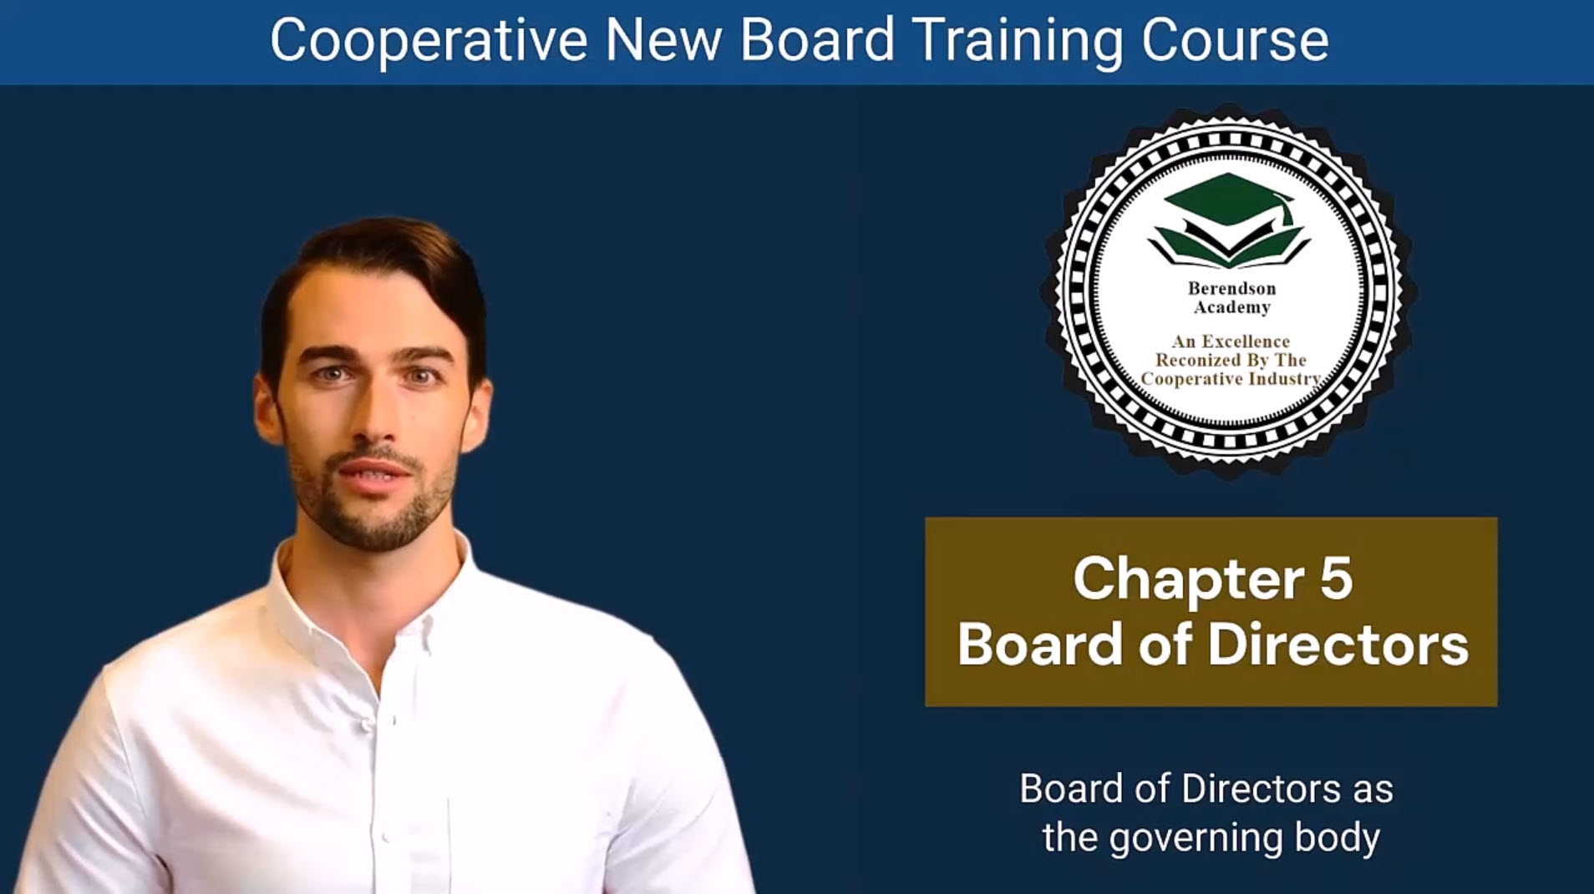

Slide 46
Chapter 5 – Board of Directors: Guiding the Mission
The Board sets the strategic direction and ensures mission alignment.
Responsibility for every phase of co-op operations rests with the Board.
Tasks may be delegated to managers or committees—but accountability cannot be delegated.
Authority exists only within Board meetings—acting alone violates co-op ethics.
Strong boards build strong cooperatives.

Slide 47
Directors’ Core Responsibilities
Ethical Responsibilities
  Uphold integrity, trust, and transparency.
  Promote community engagement and sustainability.
Duty of Care
  Participate actively in meetings and decision-making.
  Stay informed about operations and risks.

Slide 48
Directors’ Core Responsibilities
Duty of Obedience
  Follow bylaws, policies, and legal requirements.
  Ensure regulatory compliance at every level.
Integrity + informed action = responsible governance.

Slide 49
Qualities of an Effective Director
Adaptive Leadership: Embrace change and innovation.
Strategic Vision: Focus on long-term goals and member value.
Conflict Resolution: Seek collaboration, not division.
Cultural Sensitivity: Champion diversity and inclusion.
Financial Acumen: Understand budgets and financial reports.
Great directors lead with empathy, clarity, and discipline.

Slide 50
The Director’s Role in Action
Leadership & Mentorship: Develop future co-op leaders.
Resource Mobilization: Secure funds and partnerships.
Stakeholder Engagement: Build trust with members and community.
Technology Adoption: Use digital tools for efficiency and communication.
Modern boards blend tradition with innovation.

Slide 51
Legal and Ethical Duties
Maintain accurate documentation and records.
Enforce strong data protection and privacy standards.
Implement fraud prevention controls and oversight.
Serve without personal gain — with a spirit of stewardship.

Slide 52
Legal and Ethical Duties
Closing Thought:
Directorship is a calling to lead with honor, wisdom, and service—building trust, sustainability, and excellence for the entire cooperative.
Ethical leadership is the cornerstone of a thriving co-op.

Slide 53
1. Central Role of the Board:
The Board of Directors is crucial for overseeing the cooperative's strategic direction, ensuring effective governance by making informed decisions that align with the cooperative's mission and objectives.
2. Responsibilities of Directors
Board members have a range of responsibilities, including creating a vision, strategic planning, policy development, financial management, performance monitoring, and ensuring stakeholder engagement.
3. Ethical Obligations and Duties:
Directors are bound by fiduciary duties, including the duty of care and duty of obedience, requiring them to act in the best interests of the cooperative while adhering to established laws and governing documents.
4. Qualities of Effective Directors:
Successful directors demonstrate adaptive leadership, strategic vision, conflict resolution skills, cultural sensitivity, and financial acumen, all of which are essential for effective governance.
5. Importance of Interaction Between Board and Management:
The board must provide clear direction and support to the management team, ensuring collaboration and alignment in executing the cooperative's operational plans.
6. Continuous Learning and Self-Assessment:
Boards should engage in ongoing training and evaluation of their performance to enhance governance practices, adapt to changing circumstances, and better support the cooperative's growth and sustainability.

Slide 54
Chapter 5: Board of Directors Quiz
What is the primary responsibility of the Board of Directors in a housing cooperative?
A) Collecting members' monthly payments
B) Paying the cooperative's bills
C) Ensuring that various cooperative tasks are performed satisfactorily
D) Engaging with committee members
Which ethical responsibility is entrusted to directors in a cooperative?
A) Maximizing personal financial gains
B) Upholding integrity and trust
C) Avoiding engagement with the cooperative community
D) Promoting conflicts of interest
What does the duty of care for directors involve?
A) Minimizing their engagement in board meetings
B) Avoiding proactive risk management
C) Actively participating in board meetings and making informed decisions
D) Ignoring market trends and opportunities

Slide 55
Chapter 5: Board of Directors Quiz
Which quality is important for a successful director in a cooperative?
A) Inflexibility in leadership style
B) Conflict avoidance skills
C) Cultural insensitivity
D) Financial acumen
What is the role of a director in a cooperative regarding resource mobilization?
A) To actively engage in resource mobilization
B) To avoid any involvement in resource mobilization
C) To leave resource mobilization entirely to staff members
D) To focus solely on strategic vision

Slide 56
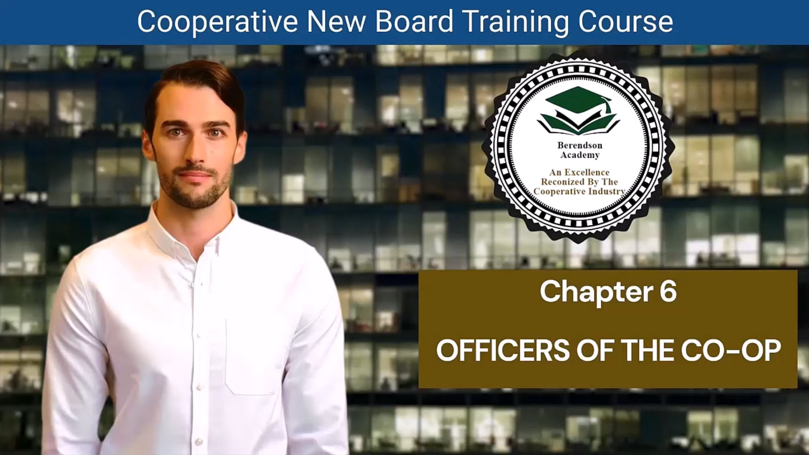

Slide 57
Chapter 6 – Officers of the Co-op: Guiding with Purpose
Officers ensure smooth and effective cooperative operations.
Each role—President, Vice President, Secretary, and Treasurer—carries distinct authority and accountability.
Their coordinated leadership safeguards the co-op’s mission, values, and financial health.
Strong officers = a stable and thriving cooperative.

Slide 58
The President’s Role
Key Responsibilities
  Oversees Operations: Ensures policies, meetings, and committees function effectively.
  Acts as Spokesperson: Represents the co-op publicly and fosters transparent communication.
  Collaborates with Professionals: Works with legal, financial, and management experts.
  Protects Assets: Oversees budgets, reserves, and financial accountability.
  Empowers Members: Encourages engagement and volunteer development.
Balance people, policy, and performance to lead with integrity.

Slide 59
The Vice President’s Role
Primary Duties
Presides over meetings in the President’s absence.
Prepares to step into the President’s role seamlessly.
Leads committees and serves as liaison across departments.
Ensures continuity of leadership and organizational stability.
A great Vice President is always ready to lead.

Slide 60
The Secretary’s Role
Core Functions
  Records accurate minutes and maintains official documents.
  Sends meeting notices and prepares agendas.
  Manages correspondence and verifies signatures or proxies.
  Ensures record retention and legal compliance.
The Secretary is the co-op’s memory—organized, reliable, and precise.

Slide 61
The Treasurer’s Role
Financial Stewardship
  Prepares and monitors the annual budget.
  Oversees reserves, insurance, investments, and audits.
  Reports regularly on financial health and compliance.
  Serves as liaison to finance committees and auditors.
  Promotes transparency and long-term fiscal sustainability.
Sound finances are the foundation of cooperative success.

Slide 62
1. Importance of Cooperative Officers:
Cooperative officers, including the president, vice president, secretary, and treasurer, play vital roles in managing and guiding the operations of the cooperative, ensuring effective governance.
2. President's Role:
The president oversees daily operations, acts as the spokesperson for the board, communicates the cooperative’s mission, and manages relationships with professionals and volunteers.
3. Vice President's Responsibilities:
The vice president supports the president by leading meetings in their absence, preparing for potential transition into the presidency, and often taking charge of central committees.
4. Secretary's Duties:
: The secretary plays a critical role in record-keeping by ensuring accurate minutes of meetings, managing correspondence, and maintaining official documents, essential for transparency and governance.
5. Treasurer's Financial Stewardship:
The treasurer oversees the financial health of the cooperative, manages budgeting processes, provides financial reporting, ensures compliance with regulations, and monitors reserve funds.
6. Commitment to Collaboration
: Each officer must work collaboratively with the board and management, demonstrating effective leadership and accountability to foster a positive and well-functioning cooperative environment.

Slide 63
Chapter 6: Officers of the Co-op Quiz
What is the primary responsibility of the president of a cooperative?
A) Managing financial records
B) Leading committee meetings
C) Overseeing daily cooperative operations
D) Handling public relations
When the president of a cooperative is unavailable, who typically steps in to lead meetings and fulfill presidential duties?
A) The treasurer
B) The vice president
C) The Secretary
D) The cooperative manager
What is the key responsibility of the secretary in a cooperative?
A) Managing the cooperative's finances
B) Preparing the annual budget
C) Recording accurate minutes of meetings
D) Overseeing the cooperative's public relations

Slide 64
Chapter 6: Officers of the Co-op Quiz
What is the primary role of the treasurer in a cooperative?
A) Managing meeting announcements
B) Leading committee meetings
C) Handling insurance coverage
D) Ensuring the cooperative's financial health
In a cooperative, who typically oversees the preparation of the annual operating budget and financial account maintenance?
A) The vice president
B) The Secretary
C) The treasurer
D) The President

Slide 65
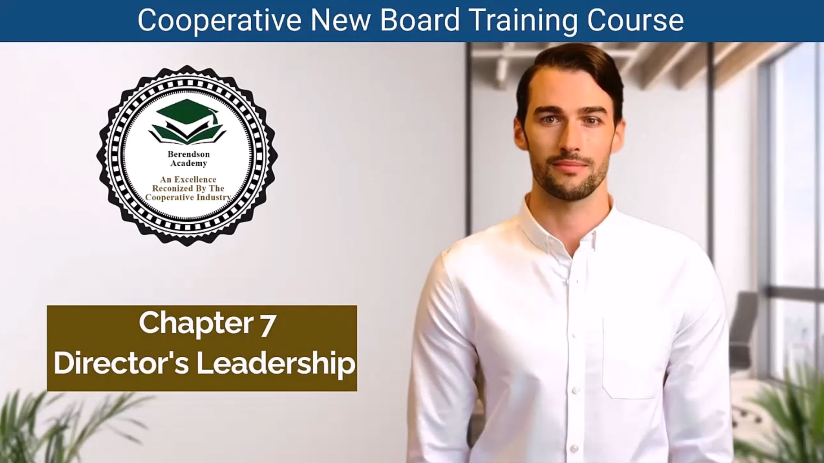

Slide 66
Chapter 7 – Directors Leadership: Inspiring with Purpose
  Leadership on the board is about vision, stewardship, and collaboration.
  Directors act as custodians of the mission, guiding strategy and upholding shared values.
  Effective leaders balance inspiration with accountability and governance.
Key Traits:
  Understand and communicate the mission and vision.
  Strengthen governance capacity and financial literacy.
  Lead through service, strategy, and community impact.
True leadership serves others while guiding with integrity.

Slide 67
Stewardship and Ethics
  Fiduciary Duty: Prioritize the co-op’s interests over personal gain.
  Code of Conduct: Promote professionalism, confidentiality, and loyalty.
  Conflict of Interest Policy: Prevent self-serving decisions.
  Code of Ethics: Align every action with cooperative principles and public trust.
  Ethical governance builds credibility and community confidence..

Slide 68
Cultivating Inclusion and Integrity
  Building a Healthy Organization:
    Diversity & Inclusion: Eliminate barriers to participation; reflect community values.
    Respect & Conduct: Review and renew the Code of Conduct annually.
    Zero Tolerance: Enforce anti-harassment and anti-discrimination policies.
    Whistle-Blower Protections: Encourage honesty, safeguard those who speak up.
  Inclusive leadership strengthens trust, belonging, and accountability.

Slide 69
Organizational Traditions & Engagement
  Sustaining a Strong Board Culture:
    Orientations & Retreats: Align vision, refresh energy, and build teamwork.
    Advocacy Support: Champion causes that uphold the cooperative’s mission.
    Member Engagement: Listen actively, communicate openly, and stay connected.
    Leadership Development: Pursue workshops, mentoring, and conflict-resolution training.
  Tradition and engagement keep the cooperative vibrant and united.

Slide 70
The Heart of Effective Leadership
  Core Leadership Reflections:
    Lead with clarity of vision and commitment to values.
    Cultivate ethical decision-making and continuous learning.
    Inspire through example, empathy, and collaboration.
    Embrace diversity and uphold organizational integrity.
  Great board leaders don’t just govern—they inspire progress and unity..

Slide 71
1. Leadership Overview:
Board members serve as leaders who inspire collaboration and commitment by aligning the cooperative’s activities with its mission and strategic goals, ensuring effective governance.
2. Shared Vision and Values:
Directors must understand and actively promote the cooperative's mission, vision, and values, facilitating a unified culture and guiding decision-making processes.
3. Director Stewardship:
: Directors hold fiduciary responsibilities, requiring them to prioritize the cooperative's interests over personal agendas and ensure transparency, accountability, and ethical conduct
4. Unique Challenges of Cooperative Management:
Cooperative directors must navigate the complexities of equitable treatment among member-owners, balancing business decisions with the needs of a diverse cooperative membership.
5. Engagement and Collaboration
Directors need to engage with members actively, involving them in decision-making while fostering a supportive community atmosphere that encourages participation and input.
6. Continuous Improvement:
Developing skills through training and self-assessment, as well as planning for leadership succession, are essential for enhancing governance practices and ensuring the board remains effective and responsive to changing community needs.

Slide 72
Chapter 7: Director Leadership Quiz
What is one of the key responsibilities of board members in effective leadership?
A) Promoting self-interest
B) Expressing negative views publicly
C) Upholding the organization's vision and mission
D) Avoiding financial literacy
What does fiduciary stewardship entail for board members?
A) Advocating for self-interest
B) Avoiding conflict of interest policies
C) Upholding accountability and avoiding self-interest
D) Publicly expressing disagreements
How can a robust code of conduct and ethics contribute to an organization's effectiveness and reputation?
A) By encouraging board members to publicly criticize the organization
B) By preventing board members from expressing their opinions
C) By setting clear behavior guidelines and promoting ethical behavior
D) By promoting self-interest among board members

Slide 73
Chapter 7: Director Leadership Quiz
What is a critical aspect of effective board leadership in promoting diversity and inclusion?
A) Encouraging participation barriers
B) Annual review of the Code of Conduct
C) Providing consequences for board members engaging in discrimination
D) Upholding ethical principles that align with the organization's mission and goals
Which of the following is a way to nurture a sense of community and relevance in a not-for-profit organization?
A) Avoiding engagement with members
B) Neglecting annual orientations and retreats
C) Actively seeking input from members and maintaining open communication
D) Discouraging stakeholder involvement in advocacy efforts

Slide 74
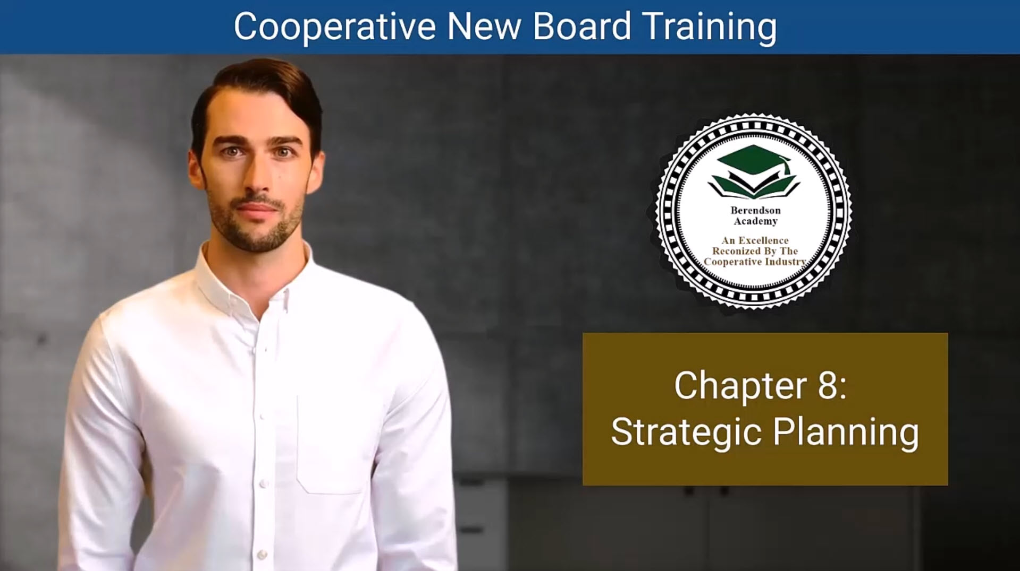

Slide 75
Chapter 8: The Power of Strategic Planning,
A strategic plan is your cooperative’s compass—guiding decisions for the next 3–5 years.
Purpose: Keeps your cooperative focused, consistent, and aligned during leadership transitions.
Key Benefits:
  Provides continuity & direction
  Aligns committees & volunteers
  Strengthens budgeting & resource allocation
  Builds awareness inside and outside the community
A cooperative without a plan drifts; one with a plan drives progress.

Slide 76
Crafting the Strategic Plan
Steps to Build an Effective Plan:
  Board Retreat: Establish a productive setting led by the President or Executive Director.
  Define Common Terms: Agree on key concepts—mission, goals, strategy.
  Review Past Performance: Learn from prior successes & gaps.
  Conduct a SWOT Analysis: Identify Strengths, Weaknesses, Opportunities, and Threats.
  Revisit Core Identity: Mission, Vision, and Values must guide all decisions.
  Set Goals & Metrics: Establish 3–5 measurable goals tied to clear accountability.
Strategic planning transforms ideas into measurable impact..

Slide 77
Teamwork That Drives Success
Every role matters in plan execution:
Plan Champion: Chief Elected Officer tracks progress and key indicators.
Goal Champions: Volunteer & staff leaders own specific objectives.
Task Owners: Manage assigned actions and report progress regularly.
When everyone knows their role, the cooperative moves forward together.

Slide 78
Values That Steer the Journey
Principles to Keep Your Plan on Course:
  Community & Inclusion: Everyone’s voice matters.
  Leadership & Growth: Foster continuous learning and improvement.
  Governance Guardrails: Strategic plans guide the path; bylaws keep it steady.
  Structure & Strategy: Align organization charts and responsibilities with goals.
  Continuous Improvement: Invest in training and programs that lift all members.
Strong principles are the cooperative’s North Star.

Slide 79
From Vision to Implementation
Making the Plan Work
  Use dashboards and progress trackers to keep the plan visible.
  Hold regular reviews to monitor progress and adapt as needed.
  Celebrate milestones and share successes across committees.
  Ensure every decision reflects your long-term goals and cooperative mission.
Strategic planning isn’t a one-time task—it’s a living roadmap to lasting success.

Slide 80
1. Significance of a Strategic Plan:
A strategic plan serves as a roadmap for the cooperative, providing direction for the next 3-5 years, ensuring continuity during leadership transitions, and aligning all members toward common objectives..
2. Benefits of Strategic Planning
Effective strategic planning helps in resource allocation, budgeting, building awareness about the cooperative, and fostering unity among committees and volunteers by ensuring everyone is working towards shared goals.
3. Crafting the Strategic Plan:
The process begins with a board retreat which includes reviewing past reports, conducting a SWOT analysis, refining the cooperative's mission and values, and establishing clear goals and strategies to reach those goals.
4. Strategic Planning Roles:
Key roles in the planning process include the Plan Champion (usually the Chief Elected Officer), Goal Champions (volunteers or staff leading specific goals), and Task Owners (responsible for implementing specific actions within the strategies).
5. Guiding Principles:
The strategic plan should reflect core values such as community, inclusion, and growth, serving as a governance roadmap while encouraging continuous improvement and adaptability within the cooperative.
6. Implementation and Monitoring:
Successful execution of the strategic plan involves regularly assessing progress against established performance metrics, maintaining transparency, and ensuring that the plan remains relevant and aligned with the cooperative's objectives.

Slide 81
Chapter 8: Strategic Planning Quiz
What is one significance of a strategic plan for a cooperative organization?
A) It leads to frequent shifts in direction with each leadership change.
B) It creates inconsistency amid leadership changes.
C) It ensures continuity and consistency in goals even with new leadership.
D) It hinders resource allocation.
What is the first step in crafting a strategic plan?
A) Establishing common terms
B) Reviewing past reports
C) Setting clear goals
D) Conducting a SWOT analysis
In the strategic planning process, who is responsible for overseeing plan progress and monitoring key indicators?
A) Goal Champion
B) Task Owner
C) Plan Champion
D) Chief Elected Officer

Slide 82
Chapter 8: Strategic Planning Quiz
What is the role of guiding principles in strategic planning?
A) To create confusion and ambiguity
B) To hinder the decision-making process
C) To influence discussions, decisions, and actions
D) To limit the options available to the cooperative
What does the "Governance Roadmap and Guardrails" principle suggest?
A) Bylaws should be discarded in favor of strategic plans.
B) Strategic plans are not necessary for cooperative governance.
C) Strategic plans should guide the board's actions, and bylaws act as guardrails.
D) Bylaws should always take precedence over strategic plans.

Slide 83
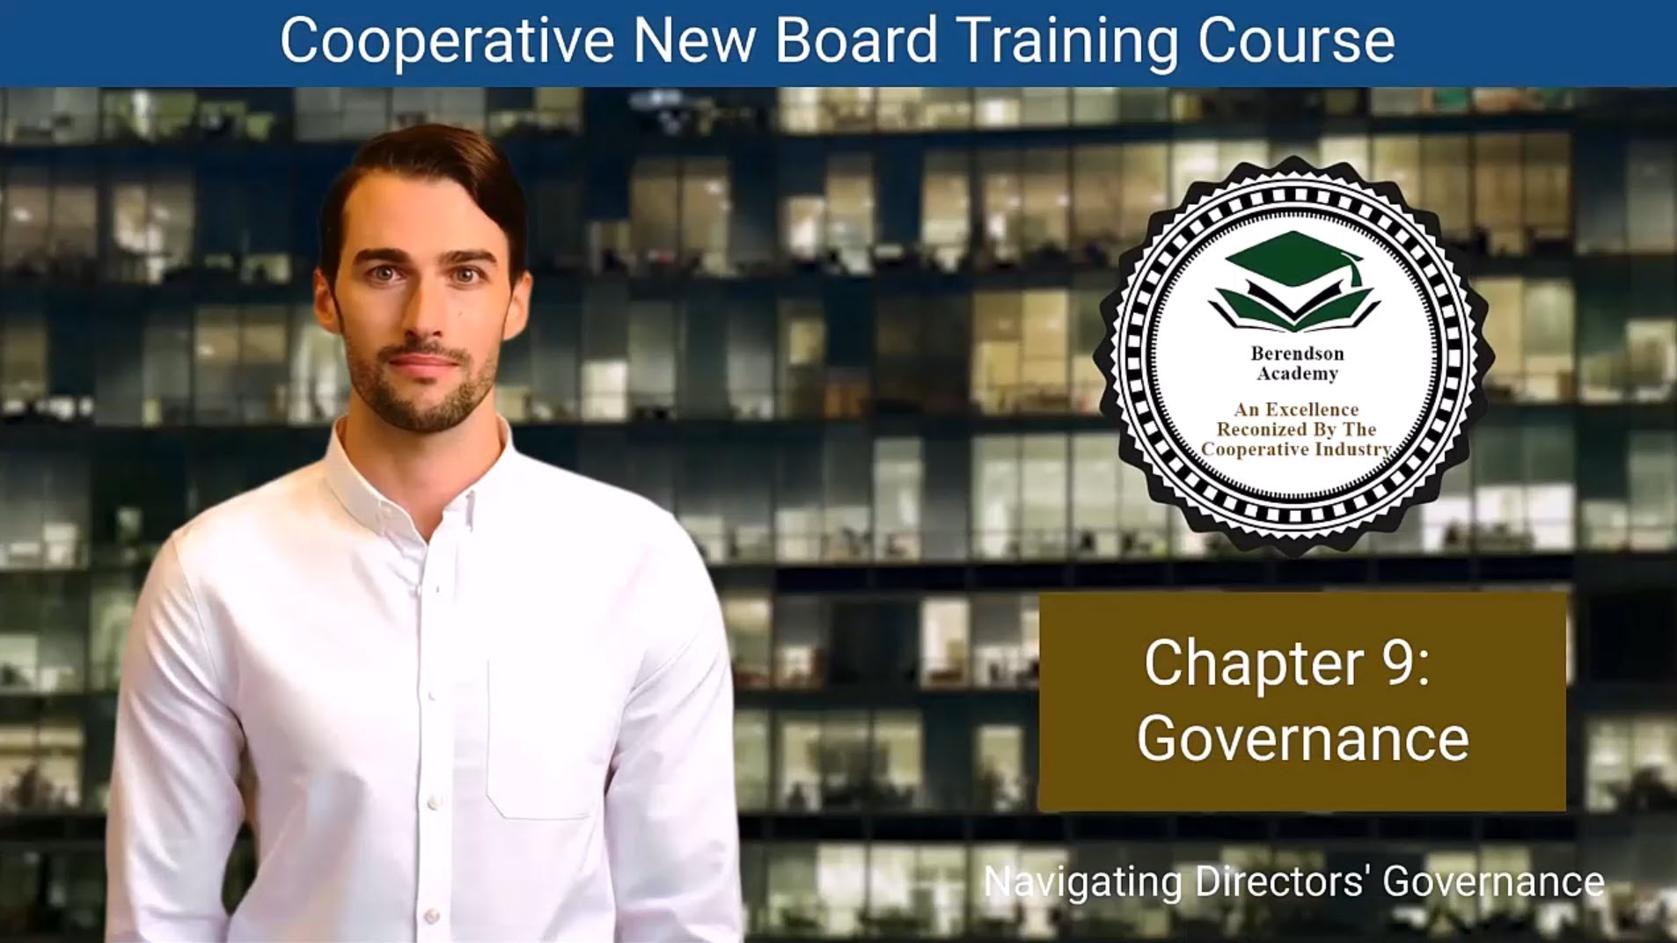

Slide 84
The Art of Governance
Guiding with Vision and Purpose
  Governance is the rudder that steers the cooperative toward its mission.
  The board’s role: shape vision, set policy, allocate resources, and ensure accountability.
  Effective boards stay strategic, not operational—focusing on the “big picture.”

Slide 85
The Art of Governance
Core Governance Duties:
  Create & uphold the mission and vision
  Oversee strategic planning & performance
  Develop policies and manage risk
  Engage stakeholders and safeguard resources
Governance leads the ship—management rows it forward.

Slide 86
Governing vs. Managing
Finding the Right Balance
  Governance = Strategy & Oversight
  Management = Operations & Execution
To maintain balance:
  Avoid micromanagement—trust professional staff or managers.
  Build a partnership of respect and communication.
  “Trust but verify” through reports, audits, and performance data.
  Ensure directors stay in their lane—policy, not procedure.
Strong boards inspire; they don’t interfere.

Slide 87
Growing as a Board and as Leaders
Growing as a Board and as Leaders
Steps to Strengthen Board Governance:
  Self-Assess Regularly: Review performance and effectiveness.
  Train Continuously: Attend workshops and leadership programs.
  Plan for Succession: Mentor new leaders for continuity.
  Engage Stakeholders: Listen, communicate, and include community feedback.
  Evaluate Impact: Measure governance results, not just activity.
Excellence in governance grows through learning, reflection, and renewal.

Slide 88
The Gospel of Good Governance
Principles That Build Trust and Success
  Trust & Integrity: Operate with honesty and transparency.
  Balanced Partnership: Respect roles between board and staff.
  Strategy over Detail: Stay focused on long-term goals.
  Continuous Improvement: Always refine processes and knowledge.
  Member-Centric Focus: Serve the community, not personal interests.
  Efficiency & Brevity: Keep meetings meaningful and outcomes measurable.
Good governance is not a task—it’s a culture.

Slide 89
1. Role of Governance:
Governance acts as the guiding force for a cooperative, ensuring that decisions align with the cooperative's mission and values while adhering to legal and ethical standards. The board holds the primary responsibility for governance.
2. Broad Responsibilities:
The board's responsibilities encompass creating a vision, strategic planning, policy development, resource allocation, performance monitoring, stakeholder engagement, and risk oversight to steer the cooperative toward its objectives.
3. Emphasis on Mission and Vision
The board plays a crucial role in ensuring that the cooperative's mission and vision statements remain relevant and are effectively communicated throughout the organization, fostering a sense of purpose among members.
4. Distinguishing Governance from Management:
Effective governance involves striking a balance by focusing on strategic governance rather than micromanagement, allowing staff to handle daily operations while the board oversees broader goals
5. Continuous Improvement:
Governance is an evolving process, and boards should assess their effectiveness regularly, invest in training opportunities, and engage with stakeholders to enhance responsiveness and adapt to changing conditions.
6. Guiding Principles of Governance:
Good governance is characterized by trustworthiness, transparency, balanced partnerships between the board and management, prioritization of strategy and policy, accountability.

Slide 90
Chapter 9: Governance Quiz
What is the primary role of governance in a cooperative organization?
A) Managing day-to-day operations
B) Crafting a vision and setting long-term goals
C) Focusing on operational discussions
D) Handling resource allocation
How can a board ensure that it stays focused on governance and doesn't delve into day-to-day management discussions?
A) Encourage micromanagement
B) Regularly assess governance effectiveness
C) Appoint board members as managers
D) Avoid self-assessment and training
What is the significance of mission and vision statements in governance?
A) They have no impact on governance.
B) They guide the organization's purpose and values.
C) They should be ignored during governance discussions.
D) They are only relevant to staff members.

Slide 91
Chapter 9: Governance Quiz
Why is it important for directors to avoid micromanagement in governance?
A) Micromanagement leads to effective governance.
B) It undermines the effectiveness of governance.
C) It fosters a balanced partnership between the board and staff.
D) It enhances communication and transparency.
What is one step an organization can take to enhance its governance practices?
A) Avoid board self-assessment
B) Disregard stakeholder feedback
C) Invest in training for board members
D) Neglect succession planning

Slide 92
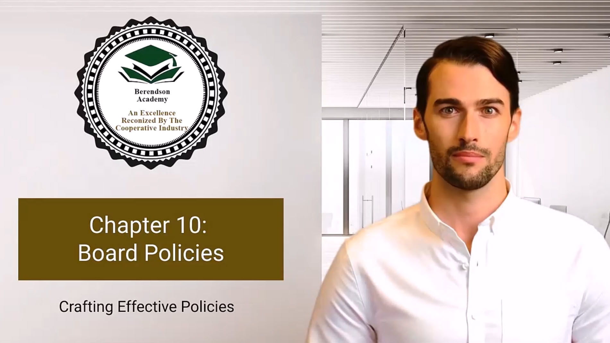

Slide 93
Chapter 10 Why Policies Matter
Policies: The North Star of Good Governance
  Policies interpret and clarify bylaws, articles, and mission statements.
  They ensure continuity when board members change, avoiding repetitive debates.
  Serve as evidence of due diligence—protecting the board from liability.
  Provide structure, consistency, and accountability across all operations.
  Distinguish policy (what & why) from procedure (how & who).
Policies set direction—procedures make it happen.

Slide 94
The Art of Policy Development
A comprehensive process ensures clarity and alignment:
  Identify the Issue — recurring or unclear board topics signal policy needs.
  Check Alignment — verify consistency with bylaws and legal requirements.
  Research (Environmental Scan) — review how similar organizations handle the issue.
  Draft Clearly — concise, plain-language policies are easier to follow.
  Consult Stakeholders — seek member, legal, and accounting input.
  Adopt Formally — vote, document, and record adoption date.
  Update the Policy Manual — make it accessible and reviewed regularly.
A written, adopted, and reviewed policy is a living governance tool.

Slide 95
Avoiding Common Pitfalls
Policy Traps to Watch Out For
  Don’t bury policies inside the bylaws.
  Avoid conflicting language with existing governing documents.
  Prevent “policy mania” — keep it concise (20–50 solid policies is typical).
  Transcribe decisions from minutes annually—don’t rely on memory.
  Review every five years; remove outdated or redundant statements.
Too many or unclear policies can weaken, not strengthen, governance.

Slide 96
Examples of Essential Policies
Every Cooperative Should Have These in Place
  ✅ Antitrust Avoidance – prevent illegal discussion of prices or competition.
  ✅ Savings Reserve – maintain six months of operating income for emergencies.
  ✅ Insurance Coverage – secure D&O, liability, and other needed protections.
  ✅ Financial Audit – annual independent CPA review for transparency.
  ✅ Record Retention – consistent schedule for digital and paper documents.
  ✅ CEO Evaluation – periodic, confidential performance review process.
  ✅ Consent Agenda – streamline meetings for efficiency.
  ✅ Logo Use / Event Policies – manage branding and liability.

Slide 97
Keeping Policies Alive
From Written Words to Daily Practice
  Make policies accessible to all board and staff members.
  Link each to clear procedures and accountability.
  Annotate adoption/amendment dates for easy tracking.
  Conduct sunset reviews every 3–5 years to ensure relevance.
  Train new board members in existing policies upon orientation.
A policy not shared or reviewed is a policy forgotten.

Slide 98
1. Purpose of Policies:
Policies serve as essential guidelines for cooperative operations, helping to interpret broader governing documents such as bylaws and mission statements, ensuring continuity in governance and protecting the organization’s integrity.
2. Distinction Between Policies and Procedures:
Policies are high-level guidelines that govern behavior and decision-making, while procedures are specific administrative steps that outline how to implement those policies. Understanding this distinction is crucial for effective governance.
3. Process for Creating Effective Policies:
The process involves identifying the need for a policy, assessing existing solutions, drafting clear and actionable rules, communicating transparently with members, and ensuring consistent enforcement while allowing for member feedback.
4. Criteria for Good Rules:
Effective policies should be legal, necessary, effective, reasonable, clear, and enforceable. These characteristics ensure that policies serve their intended purpose without causing confusion or unfair treatment among members.
5. Common Policies in Cooperatives:
Important policies may include antitrust avoidance, financial audits, reserve funds, insurance coverages, record retention, and guidelines for member behavior.
6. Policy Management:
includes regular reviews, ensuring they are accessible to members, documenting changes, and educating members about their responsibilities under these policies to promote compliance and understanding.

Slide 99
Chapter 10: Policies Quiz
What is the primary purpose of policies in an organization's governance?
A) To manage day-to-day operations
B) To provide guidance on staff responsibilities
C) To safeguard the organization's integrity and provide clear direction
D) To amend the organization's bylaws
Why should policies be kept separate from bylaws in an organization?
A) Bylaws are easier to amend compared to policies.
B) Bylaws are administrative in nature and not relevant to governance.
C) Policies can be adopted more easily and require fewer approvals.
D) Bylaws should remain broad governing documents without specific policy details.
What are some common errors in policy adoption that organizations should avoid?
A) Including policies in the bylaws
B) Focusing on policy development excessively
C) Conducting an environmental scan of other organizations
D) Engaging in lengthy discussions to develop policies

Slide 100
Chapter 10: Policies Quiz
What is the purpose of an antitrust avoidance policy in an organization?
A) To encourage competitive practices and pricing discussions
B) To prevent legal complications related to antitrust laws
C) To promote free enterprise and competition
D) To outline staff responsibilities in antitrust compliance
Why is it essential for organizations to maintain a savings reserve, as mentioned in the common policies section?
A) To fund ongoing day-to-day operations
B) To cover routine and expected expenses
C) To protect the organization's financial stability during unforeseen circumstances
D) To invest surplus funds for future growth

Slide 101
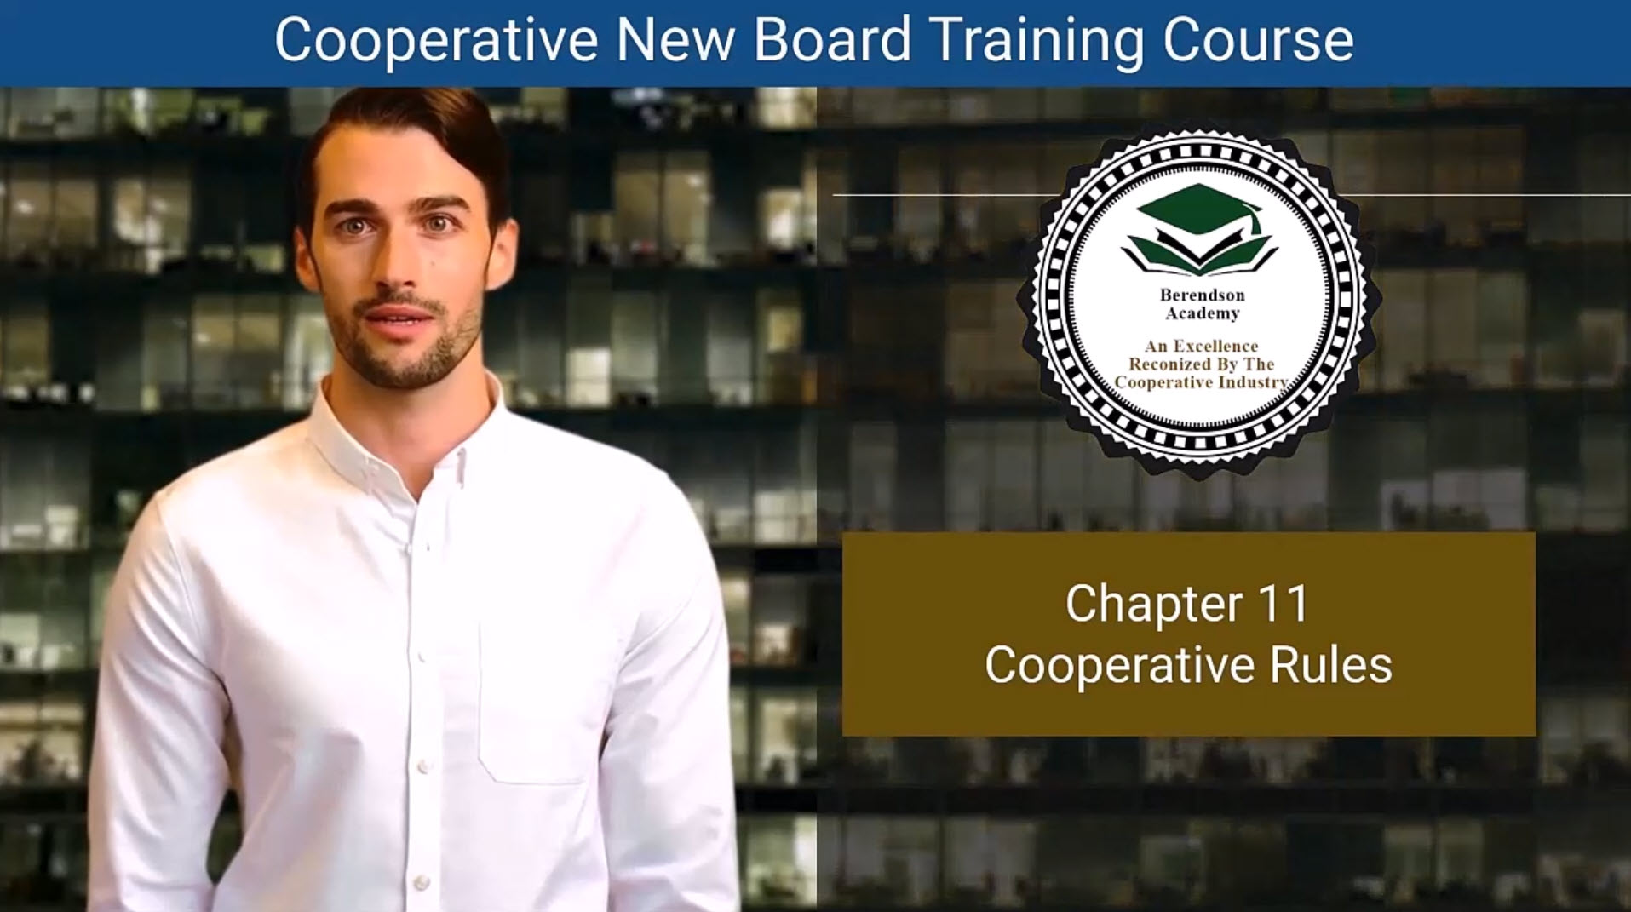

Slide 102
Why Rules Matter
The Foundation of Harmony in Cooperative Living
  Rules preserve aesthetics and protect property values.
  They enforce governing documents (CC&Rs, bylaws, policies).
  Ensure responsible use and maintenance of common areas.
  Promote fairness, safety, and consistency across the community.
  Good rules protect both the individual member and the collective community.
Rules aren’t restrictions — they’re tools for harmony and shared respect.

Slide 103
The Rule-Making Process
Title: Creating Rules that Work — and Last
  Identify the Issue: Focus on real problems or gaps in existing rules.
  Check Authority: Ensure the co-op has legal and governing authority.
  Draft Clearly: Specify what behavior is expected, when it applies, and penalties.
  Engage Residents: Communicate openly, share drafts, and gather feedback.
  Adopt & Notify: Approve formally, then provide a 30-day notice before enforcement.
  Enforce Fairly: Apply rules consistently and equally to all residents.
Transparency + Participation = Compliance.

Slide 104
Characteristics of Effective Rules
What Makes a Rule “Good”
  ✅ Legal — Aligned with federal, state, and local laws.
  ✅ Necessary — Addresses genuine community needs.
  ✅ Effective — Achieves intended outcomes.
  ✅ Reasonable — Fair, practical, and easy to follow.
  ✅ Clear — No ambiguity; simple language.
  ✅ Enforceable — Can be applied uniformly.
Pro Tip: Review rules regularly. Laws and community needs evolve — your rules should too.

Slide 105
Encouraging Voluntary Compliance
Fostering Cooperation Over Conflict
  Educate: Orient new residents on rules and their purpose.
  Explain Intent: Reinforce that rules exist to protect—not punish.
  Seek Input: Invite feedback through committees and surveys.
  Communicate Often: Use newsletters, websites, and postings.
  Be Consistent: Apply the same standards to everyone.
  Support Staff: Empower enforcement with board backing.
When residents feel heard, they’re more likely to comply willingly.

Slide 106
Continuous Evaluation & Improvement
Fostering Cooperation Over Conflict
  Educate: Orient new residents on rules and their purpose.
  Explain Intent: Reinforce that rules exist to protect—not punish.
  Seek Input: Invite feedback through committees and surveys.
  Communicate Often: Use newsletters, websites, and postings.
  Be Consistent: Apply the same standards to everyone.
  Support Staff: Empower enforcement with board backing.
When residents feel heard, they’re more likely to comply willingly..

Slide 107
Continuous Evaluation & Improvement
Keeping Rules Relevant and Fair
  Regularly review and update rules with legal and management guidance.
  Eliminate outdated or unnecessary regulations.
  Assess if rules still enhance resident life and community reputation.
  Communicate all changes clearly and promptly.
  Reinforce that cooperative rules evolve with the community’s needs.
A thriving cooperative adapts, communicates, and leads with fairness.

Slide 108
1. Importance of Rules
Rules are fundamental to the stability and harmony of a cooperative community. They help preserve aesthetics, protect property values, enforce governing documents, and maintain common areas, ensuring a well-functioning environment.
2. Reviewing Current Rules:
Before establishing new rules, it's crucial to assess existing regulations, identify current problems within the community, determine if these issues are already addressed elsewhere, and confirm the cooperative's authority to enact new rules.
3. Process for Creating Effective Rules:
Creating effective rules involves careful planning, including thinking about the long-term implications, drafting clear guidelines, communicating transparently with members, gathering feedback, and ensuring consistent application of rules.
4. Characteristics of Good Rules
Effective rules must be legal, necessary, effective, reasonable, clear, and enforceable. This ensures they serve a legitimate purpose without resulting in confusion or unfairness within the community.
5. Formalizing Cooperative Rules:
: Establishing strong rules requires consulting experts, setting clear procedures for implementation, involving community members in the discussion, and maintaining an ongoing review process to adapt to changing circumstances.
6. Strategies for Voluntary Compliance:
Encouraging residents to follow rules voluntarily involves direct communication about problematic behaviors, explaining the intentions behind rules, gathering resident input before finalizing decisions, and providing clear communication about any changes.

Slide 109
Chapter 11 COOPERATIVE RULES: Quiz
Why are rules and regulations essential in a cooperative community, and how do they contribute to the well-being of the community?
A) They provide opportunities for residents to express their creativity.
B) They serve as guidelines for enforcing governing documents.
C) They discourage resident cooperation and harmony.
D) They create confusion and chaos within the community.
What steps should a cooperative community take when considering the creation of new rules?
A) Implement new rules without seeking resident input.
B) Rush the rule-making process to address issues quickly.
C) Engage residents, seek feedback, and communicate the need for new rules clearly.
D) Avoid any legal considerations and rely solely on governing documents.
How can you ensure newly drafted rules are clear, comprehensive, and enforceable?
A) Make rules complex and open to interpretation.
B) Seek legal counsel to ensure alignment with governing documents and laws.
C) Avoid specifying penalties for non-compliance.
D) Communicate rules only through verbal conversations.

Slide 110
Chapter 11 COOPERATIVE RULES: Quiz
Why is consistency in rule enforcement crucial, and how can a cooperative community achieve it?
A) Inconsistent enforcement fosters trust and harmony.
B) Consistency prevents potential legal challenges and maintains trust within the community.
C) Inconsistent enforcement encourages resident cooperation.
D) Consistency leads to confusion and misunderstandings.
What are some proactive approaches for addressing rule violations before they occur?
A) Ignore potential rule violations until they become major issues.
B) Clarify the authority behind rule creation and enforcement.
C) Avoid discussing rule violations with residents.
D) Create a committee to evaluate rule violations after they happen.

Slide 111
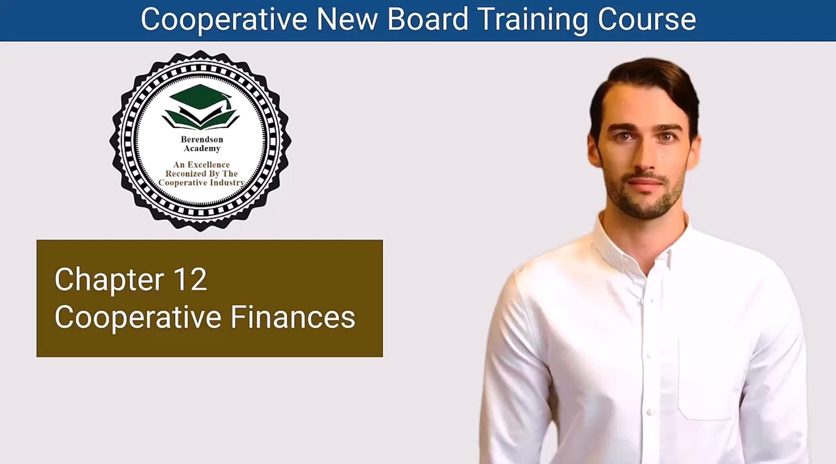

Slide 112
Chapter 12 Safeguarding the Cooperative’s Wealth
The Board’s Role in Financial Stewardship
Key Points:
  Protect Assets: Use checks and balances and conservative investments to keep funds secure.
  Insurance as Protection: Adequate coverage defends property—the cooperative’s “crown jewels.”
  Manage Risk: Anticipate challenges; plan policies to minimize exposure.
  Income Defense: Consistent collection policies maintain cash flow stability.
  Prevent Waste: Diligent oversight stops fraud, waste, and mismanagement.
  Maintain Property: Proper upkeep preserves long-term community value.
Strong financial stewardship isn’t about numbers—it’s about protecting people’s homes.

Slide 113
Budgeting: The Art of Financial Foresight
Turning Numbers Into a Vision
  Objective Planning: Base budgets on data, not guesswork.
  Realistic Expenses: Account for maintenance, weather impacts, and inflation.
  Comprehensive View: Include taxes, insurance, and expected delinquencies.
  Income Projection: Anticipate late payments—plan for cash flow dips.
  Long-Term Vision: Build 3–5 year financial plans to prepare for future needs.
A budget is not just a spreadsheet—it’s your roadmap for sustainability.

Slide 114
Building and Managing Reserves
Your Community’s Treasure Chest
  Reserve Studies: Use professionals to assess life cycles and replacement costs.
  Regular Updates: Review every 1–5 years to adjust for price and condition changes.
  Owner Buy-In: Educate members on why reserves prevent future crises.
  Funding Strategies: Choose between full, baseline, or threshold funding.
  Invest Wisely: Follow written policies balancing safety, liquidity, and yield.
Well-funded reserves = stability, trust, and financial independence.

Slide 115
Using and Protecting Reserve Funds
Keeping the Treasure Safe
  Purpose: Reserves are for repairs and replacements—not new projects.
  Proper Funding: Avoid underfunding; it leads to special assessments.
  Transparency: Share reserve study results with owners regularly.
  Clear Policy: Document how and when reserves can be used.
  Regular Review: Adjust plans to match community age and condition.
Reserves are not an emergency fund—they are a long-term commitment.

Slide 116
Financial Mastery & Legacy
Crafting a Financially Resilient Future
  Boards are guardians of community assets, not just managers.
  Educate, plan, and seek expertise—sound financial governance builds trust.
  Maintain compliance with state and federal regulations.
  Transparency and reporting strengthen confidence among members.
  Each decision contributes to a lasting legacy of stability and care.
You’re not just managing money—you’re shaping the cooperative’s legacy of prosperity.

Slide 117
1. Importance of Financial Management
: Effective financial management is crucial for ensuring the cooperative's financial health and stability, protecting assets, and securing the community’s future through prudent policies and oversight.
2. Protecting Assets and Income:
The board should implement checks and balances to protect cash assets and maintain proper insurance coverage for properties. Additionally, consistent income collection policies are necessary to ensure financial stability.
3. Budgeting as a Strategic Art:
Budgeting should be approached methodically by combining historical data with realistic projections, ensuring that all costs are accounted for, including taxes and potential late payments, to create a comprehensive and effective financial plan.
4. Establishing and Managing Reserves:
Reserve funds act as a financial safety net for the community, allowing for addressing unexpected expenses without the need for borrowing. Regularly updated reserve studies and a clear funding strategy are vital for managing these funds effectively.
5. Investment Policy Development:
A written investment policy should guide the cooperative’s investment decisions, balancing safety, liquidity, and yield while aligning with the community’s financial objectives and risk tolerance.
6. Financial Planning and Reporting:
The management team should provide the board with accurate financial reports, ensuring compliance with regulations and establishing robust internal controls.

Slide 118
Chapter 12 Cooperative Finance Quiz
How can the board ensure that cash assets are protected effectively through checks and balances procedures?
A) By allocating all cash assets to a single account
B) By avoiding any financial policies and procedures
C) By implementing prudent financial policies and investments
D) By relying solely on insurance coverage
What steps can the board take to ensure the association has adequate insurance coverage for its physical assets?
A) Avoid purchasing any insurance to save money
B) Regularly update reserve studies to determine coverage needs
C) Ignore the need for insurance and rely on the board's financial expertise
D) Purchase insurance without assessing coverage requirements
Why is it essential to develop the budget objectively based on historical data and research?
A) To make budgeting decisions based on assumptions alone
B) To avoid including taxes, insurance premiums, and expected defaults in the budget
C) To create a budget that is not realistic in terms of expenses
D) To ensure accurate and informed financial planning

Slide 119
Chapter 12 Cooperative Finance Quiz
Why are reserve funds crucial for a community association's financial planning?
A) To fund new projects and enhancements
B) To cover pet projects and parties
C) To address unforeseen expenses and repair or replace common elements
D) To provide a financial cushion for everyday expenses
What are some common federal and state regulations that community associations must consider when managing their finances?
A) Regulations are not relevant to community associations' finances
B) Regulations pertaining to insurance coverage only
C) Regulations that pertain to taxes, financial reporting, and governing documents
D) Regulations that encourage community associations to ignore financial planning

Slide 120
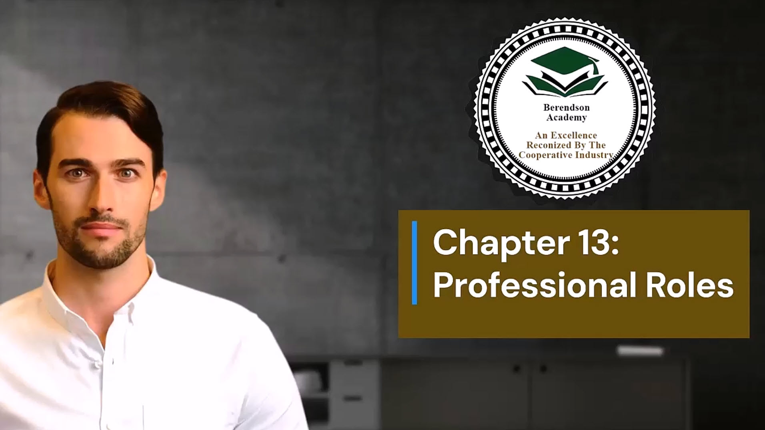

Slide 121
Chapter 13 Partnering for Success
Working with Professionals: Building Strong Foundations
Overview:
Your cooperative’s success depends on a team of trusted experts—each providing vital knowledge that complements board leadership.
Key Idea: Boards govern. Professionals guide.
Core Partners:
  Attorney – Ensures legal compliance & protection
  CPA – Safeguards financial integrity
  Insurance Agent – Manages risk & protection
  Reserve Specialist – Preserves assets for the future
Strong boards are never alone—they lead through collaboration.

Slide 122
The Attorney: Legal Guidance & Protection
Key Roles:
  Reviews bylaws, contracts, and rules for compliance
  Provides legal opinions to guide board actions
  Educates boards & residents on rights and obligations
  Handles collections, deed enforcement, and litigation
Best Practices:
  Choose an attorney specializing in community association law
  Designate one board contact to streamline communication
  Remember: the attorney represents the association—not individuals
A good attorney prevents problems before they happen.

Slide 123
The CPA: Financial Health & Transparency
Key Roles:
  Conducts audits, reviews, and budget analyses
  Designs accounting systems and internal controls
  Advises on reserves, investments, and fiscal planning
  Educates the board on financial reports and compliance
Why It Matters:
  Promotes accountability & trust with members
  Ensures accurate reporting for long-term stability
  Helps boards make data-driven financial decisions
Financial clarity leads to confident leadership.

Slide 124
The Insurance Agent: Risk Management & Security
Key Roles:
  Reviews documents to ensure coverage meets legal minimums
  Conducts risk inspections and verifies property values
  Advises on liability, fidelity bonds, and disaster protection
  Educates residents on coverage boundaries
Board Tips:
  Work with agents experienced in community associations
  Review coverages annually and after major repairs
  Promote transparent claims procedures
Prepared communities recover faster.

Slide 125
The Reserve Specialist: Planning for the Future
Key Roles:
  Performs reserve studies to forecast repair & replacement costs
  Calculates component lifespans & funding needs
  Helps boards establish realistic reserve contributions
  Guides ethical contractor selection & bid processes
Why It Matters:
  Prevents financial shocks from major repairs
  Strengthens long-term sustainability and property value
  Provides clarity for budgeting and owner communication
Today’s planning secures tomorrow’s community.

Slide 126
1. Critical Roles of Professionals:
: Professionals, such as attorneys, CPAs, insurance agents, and reserve specialists, provide essential expertise and guidance that strengthen the operations and governance of community associations.
2. The Attorney: Legal Guidance:
Attorneys specializing in community association law help ensure compliance with governing documents and state regulations.
3. The Certified Public Accountant (CPA): Financial Oversight: CPAs
CPAs bring financial expertise beyond day-to-day bookkeeping, conducting audits, preparing financial reports, developing policies, and providing training on financial matters to ensure the cooperative's economic health and transparency.
4. The Insurance Agent: Risk Management:
Insurance agents with knowledge of community associations help identify coverage needs, ensure proper property valuation, and provide education on members’ insurance responsibilities.
5. The Reserve Specialist: Asset Preservation:
Reserve specialists conduct detailed reserve studies to guide financial planning for maintenance and replacement of community assets. Their expertise helps cooperatives plan for future expenses effectively.
6. Collaborative Support for Success
: By fostering strong partnerships with these professionals, cooperatives can improve operational efficiency, ensure legal compliance, bolster financial health, and enhance the overall quality of community living.

Slide 127
Chapter 13: Working with Professionals Quiz
What is the primary reason for selecting an attorney with expertise in community association law for your community association?
a) To reduce legal expenses
b) To improve communication within the board
c) To ensure compliance with governing documents and regulations
d) To handle routine administrative tasks
How can Certified Public Accountants (CPAs) benefit a community association?
a) By handling day-to-day bookkeeping tasks
b) By providing legal guidance
c) By offering investment advice
d) By assisting with financial reporting, budgeting, and audits
Why is it crucial for insurance agents working with community associations to have specialized knowledge?
a) To provide discounts on insurance premiums
b) To simplify the insurance process
c) To ensure the association has appropriate coverage tailored to its unique needs
d) To expedite claims processing

Slide 128
Chapter 13: Working with Professionals Quiz
What is the primary role of reserve specialists in a community association?
a) Conducting routine property inspections
b) Preserving physical assets through detailed reserve studies
c) Managing day-to-day financial operations
d) Reviewing governing documents for compliance
How can professionals such as attorneys, CPAs, insurance agents, and reserve specialists benefit a community association collectively?
a) By increasing association fees
b) By providing legal protection for individual homeowners
c) By ensuring seamless operations, legal compliance, and financial prosperity
d) By minimizing the role of board members in decision-making

Slide 129
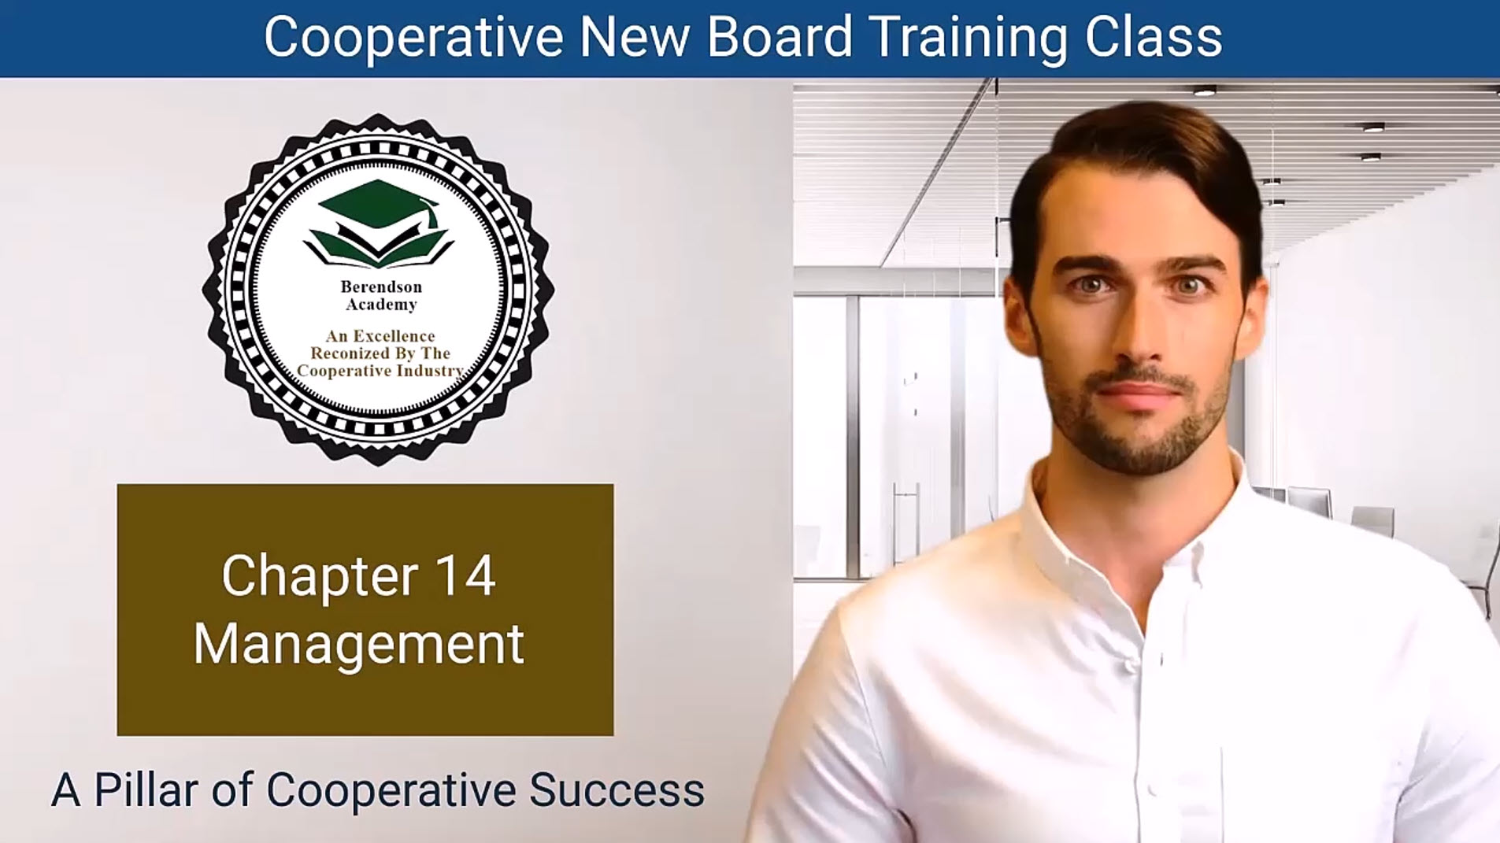

Slide 130
Chapter 14 Management = Mission In Motion
Board–Management Partnership
  Big Idea: The board governs; management executes. Success requires clarity + cadence.
Board’s Role
  Set mission, vision, strategy, guardrails
  Hire/support the chief executive; review performance
  Oversight of finance, risk, and results (not daily ops)
Management’s Role
  Turn strategy into operations & service delivery
  Provide timely reports (KPIs, risks, finance)
  Steward people, capital, facilities; engage stakeholders

Slide 131
How Co-op Management Is Different
Managing a Member-Owner Enterprise
What’s Unique
  Member = owner = customer → service first, low margins, transparent choices
  Equitable treatment → clear financing & patron policies
  Democracy → major decisions need owner buy-in
  Service culture → every interaction signals value

Slide 132
How Co-op Management Is Different
Managing a Member-Owner Enterprise
Core Resources & Functions
  People (hire, train, motivate)
  Capital (budgets, reserves, controls)
  Facilities (maintenance plans, compliance)
  Management cycle: Plan → Organize → Motivate → Control

Slide 133
Selecting Management (or a Mgmt Company)
Selection Criteria
  Proven co-op experience & references
  Capacity: systems, tech, accounting, staffing
  Alignment with co-op values & transparency
  Clear fee model; performance reporting
RFP Essentials
  Scope of services & deliverables
  Qualifications required; evaluation criteria
  Timelines; reporting cadence & communication norms

Slide 134
Selecting Management (or a Mgmt Company)
Governance Tips
  Declare conflicts; standardize scoring
  Interview short-list; check references deeply
  Decide as a board; document rationale

Slide 135
Managing by Objectives (EMBO)
From Plans to Performance
Framework
  Clear Objectives: tied to strategy (finance, ops, service, risk)
  KPIs: measurable indicators per objective
  Commitment: board + management co-own outcomes
  Cadence: monthly dashboards; quarterly deep-dives
  Course-Correct: log risks, blockers, and actions
Benefits
  Alignment • Transparency • Accountability
  Agility to adapt • Member-focused results

Slide 136
Oversight Cadence & Risk Controls
Keep the Engine Safe & Smart
Financial Oversight
  Budget vs. actuals; cash & reserves health
  Internal controls; audit/review schedule
  Investment & reserve policies
Risk & Compliance
  Risk register; mitigation plans; insurance fit
  Policy adherence; legal & regulatory updates

Slide 137
Oversight Cadence & Risk Controls
Keep the Engine Safe & Smart
People & Stakeholders
  CEO goals & review; staff development signals
  Stakeholder feedback loops & service metrics
Board–Mgmt Rhythm
  1-page dashboard monthly; consent agenda for routine items
  Focus meetings on strategy, risk, and results—not tasks

Slide 138
1. Importance of Effective Management:
Management is critical for the success of housing cooperatives, ensuring that the board's decisions are executed and that daily operations run smoothly to meet the cooperative's objectives.
2. Collaboration Between Board and Management
The board provides direction while management implements strategies, oversees operations, and manages relationships with stakeholders.
3. Key Responsibilities of Management:
Providing Clear Direction:
Performance Monitoring:
Financial Management:
4. Unique Challenges of Cooperative Management:
Cooperative managers face distinct challenges, such as catering to the needs of member-owners and ensuring equitable treatment among them, which impacts decision-making and service delivery.
5. Core Resources:
Successful cooperative management encompasses managing three core resources: people (staff and board members), capital (financial assets), and facilities (buildings and equipment).
6. Management Functions:
Effective management involves four essential functions—planning, organizing, motivating, and controlling—which ensure that the cooperative operates efficiently and achieves its strategic goals

Slide 139
CHAPTER 14 MANAGEMENT Quiz
Here are the multiple-choice questions for Chapter 14 - Management:
What is the primary difference in decision-making perspective between a manager in a cooperative and a manager in a traditional business?
a) Cooperative managers prioritize profit above all else.
b) Cooperative managers focus on maximizing shareholder returns.
c) Cooperative managers prioritize what is best for the customer-owner.
d) Cooperative managers have more flexibility in choosing suppliers.
What is the role of the board in the selection process of cooperative management?
a) The board is responsible for performing all management functions.
b) The board evaluates the cooperative's needs and decides whether external management is necessary.
c) The board handles the day-to-day operations of the cooperative.
d) The board conducts interviews with potential management entities.
What is the primary purpose of an RFP (Request for Proposals) for property management services in the selection process?
a) To list the cooperative's financial assets and liabilities.
b) To outline the cooperative's board structure.
c) To communicate the cooperative's requirements, expectations, and criteria for selecting a management entity.
d) To provide a timeline of the cooperative's history.

Slide 140
CHAPTER 14 MANAGEMENT Quiz
What is the fundamental principle behind the EMBO (Evaluating Management by Objectives) system in cooperative management?
a) Rigid control over management activities.
b) Full autonomy for management without board involvement.
c) Control through commitment, with both board and management working collaboratively.
d) Micromanagement of management functions.
Why is continuous review an essential component of the EMBO system?
a) It reduces transparency in management practices.
b) It prevents adaptation to changing circumstances.
c) It helps cooperatives fine-tune their management practices, seize opportunities, and address challenges.
d) It discourages accountability for both management and the board.

Slide 141
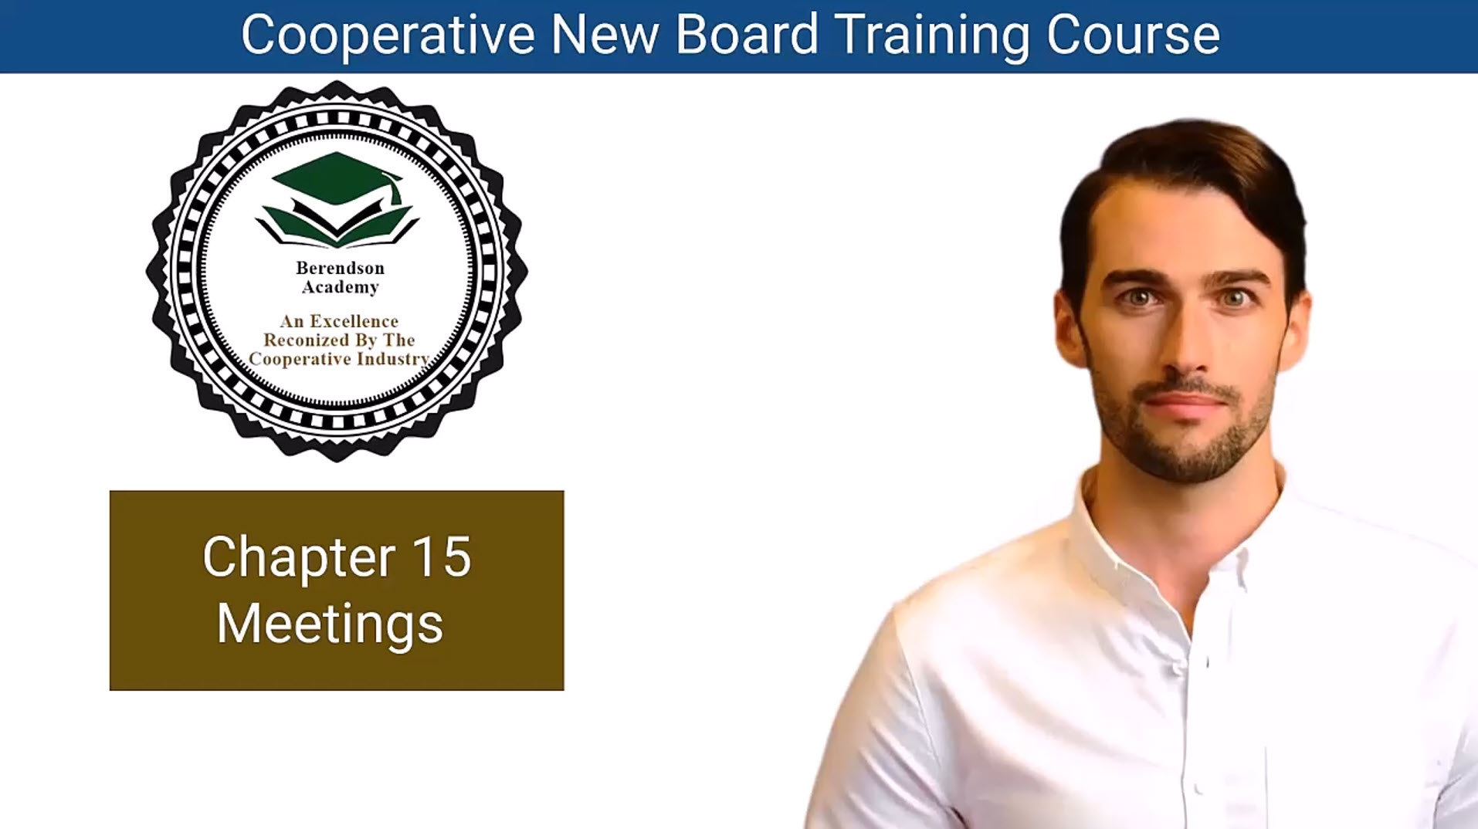

Slide 142
Chapter 15 The Purpose of Meetings
Meetings Are the Heart of Governance
Core Message: Meetings turn vision into action.
Key Points
  Primary functions: set policy • review operations • resolve issues • plan ahead.
  Conduct with precision → order, productivity, transparency.
  Effective meetings = efficient community decisions.
  Visual Idea: Circle diagram showing “Discuss → Decide → Act → Review.”

Slide 143
Annual & Special Meetings
Different Meetings, Different Purposes
Annual Meetings
  Present budget & committee reports.
  Elect directors & build community spirit.
Special Meetings
  Focus on one issue or project.
  Encourage member feedback before board action.
Requirements
  Proper notice to members.
  Achieve quorum before business begins.
Visual Idea: Two columns (Annual vs Special) with icons for budget, election, discussion, vote

Slide 144
Preparation = Productivity
Plan Ahead for Successful Meetings
Checklist
  Define clear goals & expected outcomes.
  Draft agenda that prioritizes important items.
  Choose accessible time & location.
  Send notices & materials early (via email + website).
  Start & end on time.

Slide 145
Running Effective Meetings
From Discussion to Decision
Best Practices
  Follow agenda order; prioritize action items first.
  Encourage constructive input & limit off-topic talk.
  Use motions and votes properly; record in minutes.
  Share minutes within 7 days to maintain transparency.
Avoid
  Micromanaging staff or committee details.
  Re-hashing past decisions.

Slide 146
Staying Focused & Engaged
Keep Your Meetings on Course
Common Pitfalls & Fixes
  “Squirrel!” moments → refocus on agenda.
  Board doing committee work → delegate properly.
  Endless debate → summarize & call for a vote.
  Unprepared directors → reinforce fiduciary duty.
  Side talks (“rump sessions”) → keep business public.
Culture of Improvement
  Brief reports, clear graphics, mission focus.
  Continuous training for better governance.

Slide 147
1. Importance of Meetings
Meetings are essential for community associations as they serve as platforms for decision-making, policy-setting, and fostering member engagement. They are critical to the governance and functioning of the cooperative.
2. Board Meetings:
Board meetings are at the core of association governance, where decisions are made regarding policies, operations, and member concerns. Conducting these meetings effectively promotes transparency and participation.
3. Do's and Don'ts for Effective Meetings:
Do's: Start and end on time, provide materials in advance, allocate time for agenda items, and keep thorough minutes of discussions.
4. Types of Meetings:
Key types of meetings include annual meetings, where members come together to discuss the budget, elect directors, and enhance community bonds, and special meetings, which focus on specific issues or decisions requiring immediate attention.
5. Meeting Requirements:
Legal requirements necessitate notifying members about meetings and ensuring a quorum is present to conduct business effectively. This foundation supports productive and legitimate meetings.
6. Tips for Running Effective Meetings:
Successful meetings are built on clear goals, structured agendas, accommodating logistics, timely notice distribution, and effective facilitation to ensure discussions remain focused and productive.

Slide 148
Chapter 15 Meetings Quiz
Why are meetings crucial for the functioning of community associations, and how do they contribute to the decision-making process?
a) Meetings are not crucial; they are a waste of time.
b) Meetings promote transparency but don't contribute to decision-making.
c) Meetings facilitate interactions and play a pivotal role in decision-making.
d) Meetings are essential for socializing but don't impact decision-making.
What are the primary purposes of board meetings in a community association, and how can they be optimized for efficiency?
a) Board meetings serve mainly for socializing, and efficiency is not a priority.
b) Board meetings are focused on day-to-day operations, and efficiency is irrelevant.
c) Board meetings are for setting policies, reviewing operations, and ensuring transparency, which can be optimized by following best practices.
d) Board meetings are primarily for voting on sensitive matters, and efficiency is not important.
How can diverse board members with varying perspectives work together harmoniously during meetings?
a) By ignoring diverse perspectives and focusing only on the majority opinion.
b) By avoiding discussions on sensitive topics.
c) By encouraging open dialogue, respecting different viewpoints, and seeking common ground.
d) By excluding members with differing perspectives.

Slide 149
Chapter 15 Meetings Quiz
Why is it essential for meetings to be productive and results-driven, and what strategies can help achieve this?
a) Productivity and results are not important in meetings.
b) Productivity and results can be achieved by having lengthy discussions.
c) Productivity and results ensure that meetings are efficient and effective; strategies include setting clear goals and agendas.
d) Productivity and results are secondary; meetings should focus on socializing.
How do annual meetings contribute to building a sense of community within a community association?
a) Annual meetings are not relevant to building a sense of community.
b) Annual meetings are solely for presenting budgets.
c) Annual meetings provide a platform for members to come together, strengthen bonds, and actively participate in governance.
d) Annual meetings are for electing directors, and community building is not their purpose.

Slide 150
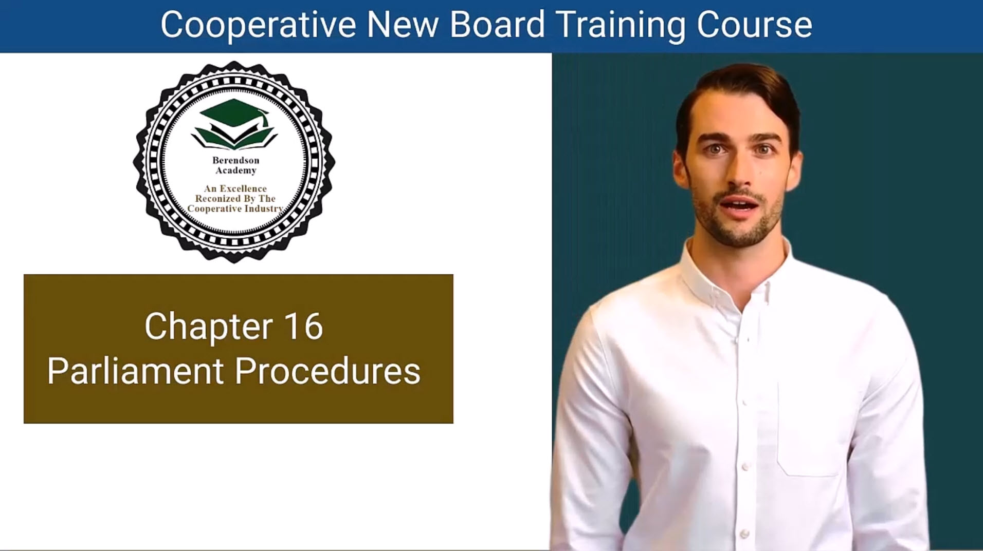

Slide 151
Chapter 16 Parliamentary Procedures Unveiled
Order, Fairness, and the Spirit of Democracy
Key Ideas
  Originated in early English Parliaments → refined in Robert’s Rules of Order Newly Revised (1876).
  Provide structure, fairness, and efficiency in meetings.
  Core Benefits:
    Democratic rule → every voice heard.
    Flexibility → adaptable to any group size.
    Protection → safeguards members’ rights.
  Basic Rules in Action: obtain the floor properly • speak clearly • respect debate rules • stay courteous.

Slide 152
Mastering Motions & Voting
The Language of Decision-Making
Motion Hierarchy
  Main Motions → introduce new business.
  Subsidiary Motions → amend or affect the main motion.
  Privileged Motions → urgent matters (e.g., adjourn).
  Incidental Motions → arise from other business.
  Reconsider → revisit decisions.
Voting Methods: Voice • Show of hands • Roll call • Ballot • General consent.

Slide 153
Essential Skills for Effective Participation
How to Engage Confidently in Meetings
Checklist for Members
  Know when a motion is in order and relevant.
  Ask for the floor before speaking.
  Support motions with a second to show shared interest.
  Keep comments short, focused, and civil.
  Understand what vote is required (majority, 2/3, etc.).

Slide 154
Beyond the Basics: Advanced Tools
Strategic Techniques for Smooth Meetings
Key Concepts
  Quorum: minimum attendance for valid action → protects majority rule.
  Adjournment: used to end a meeting properly or strategically.
  Call for the Question: ends debate → moves to vote.
  Point of Order: challenges procedure → keeps meeting on track.
  Benefits: Maintains fairness • saves time • prevents confusion • builds member confidence.

Slide 155
Embracing Parliamentary Confidence
Turning Rules into Respectful Results
Takeaways
  Parliamentary procedures = framework for order and fair decision-making.
  Encourage cooperation and constructive debate.
  Empower every member to participate effectively.
  Transform meetings into democratic forums of collaboration.

Slide 156
1. Historical Context:
: Parliamentary procedures, rooted in early English parliamentary practices, serve as a structured way to conduct meetings and make decisions
2. Importance of Parliamentary Procedures:
These procedures ensure democratic participation, flexibility, and fairness in meetings by establishing clear guidelines for decision-making and interaction among members.
3. Basic Rules of Parliamentary Procedure:
Understanding essential rules, such as making motions, obtaining the floor, and maintaining courteous debate, is crucial for effective participation in meetings. These rules help maintain order and structure during discussions.
4. Hierarchy of Motions
4. Hierarchy of Motions: Motions are categorized into main motions, subsidiary motions, privileged motions, incidental motions, and motions to reconsider. Each type serves specific functions and must be presented in an appropriate manner during meetings.
5. Advanced Techniques:
Advanced parliamentary procedures include understanding quorum requirements, strategically using motions to adjourn, calling for the question to end debates, and raising points of order to maintain procedural integrity.
6. Embracing Parliamentary Procedures
Mastering parliamentary procedures equips individuals and organizations with the skills to conduct effective meetings, fostering cooperation, transparency, and informed decision-making within cooperatives.

Slide 157
Chapter 16: Parliamentary Procedures Quiz
What is the historical significance of parliamentary procedures, and how has it evolved over time?
a) Parliamentary procedures originated in the United States and have remained unchanged since.
b) Parliamentary procedures have no historical significance.
c) Parliamentary procedures evolved from early English Parliaments and have become integral to American governance.
d) Parliamentary procedures were introduced in the 20th century as a response to technological advancements.
Why are parliamentary procedures considered valuable for conducting meetings reasonably and efficiently?
a) They are rigid and inflexible, ensuring quick decision-making.
b) They prioritize the rights of a few members over the majority.
c) They promote order, fairness, and allow all members to participate and be heard.
d) They discourage discussions and debate.
How do different methods of voting on motions serve specific purposes and enhance the decision-making process?
a) All methods of voting are the same and have no unique purposes.
b) Different methods of voting help speed up meetings but don't serve specific purposes.
c) They allow members to vote secretly and protect their privacy.
d) They cater to different situations, from voice votes for simple matters to roll call votes for recording individual choices.

Slide 158
Chapter 16: Parliamentary Procedures Quiz
What is the primary purpose of the motion to adjourn in parliamentary procedures?
a) To extend the meeting indefinitely.
b) To conclude a meeting abruptly, preventing further discussion or action.
c) To initiate a lengthy debate.
d) To call for a vote on a pending motion.
What role does the "point of order" motion play in parliamentary procedures?
a) It allows members to interrupt the speaker and take over the floor.
b) It is used to end debates on a particular motion.
c) It is a way to object to deviations from established procedures and seek a ruling from the chair.
d) It is a motion to postpone indefinitely.

Slide 159
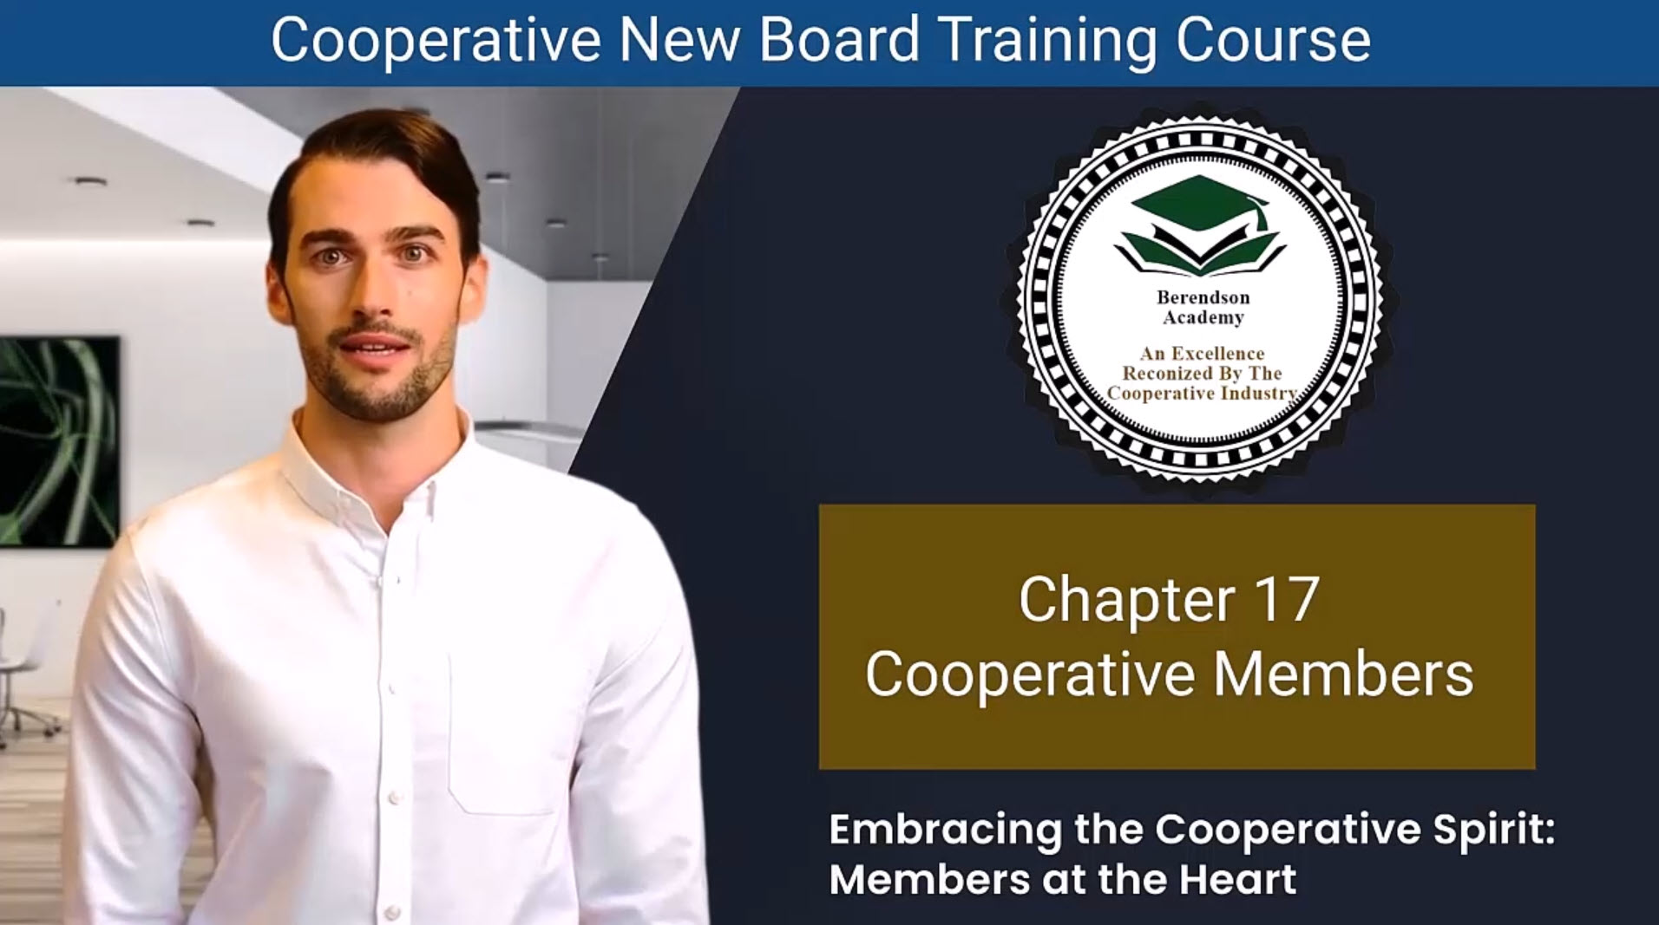

Slide 160
Chapter 17 Embracing the Cooperative Spirit
Members at the Heart of the Cooperative
Key Points:
  A cooperative is more than housing — it’s a community built on safety, dignity, and shared purpose.
  Members are not tenants — they are owners, leaders, and decision-makers.
  Members shape the cooperative by:
    Electing directors
    Approving bylaws and policies
    Voting on major decisions
  The cooperative exists for the members and because of the members.

Slide 161
Rights and Responsibilities
Your Role as a Cooperative Member
Member Rights:
  A safe, healthy, and respectful environment
  A democratic voice in decisions
  Access to information and financial transparency
  Pride and participation in the community
Member Responsibilities:
  Stay informed and attend meetings
  Pay monthly shares on time
  Support and communicate with the board
  Maintain respect, cooperation, and problem-solving spirit

Slide 162
Maintenance: The Lifeblood of the Co-op
Quality Housing, Shared Commitment
Key Ideas:
  Maintenance isn’t an expense — it’s an investment in the co-op’s future.
  Avoiding proper upkeep leads to higher long-term costs and declining property values.
  The board ensures professional management, but every member plays a part by:
    Reporting problems early
    Supporting maintenance budgets
    Taking pride in shared spaces

Slide 163
Members and the Board: Partners in Success
Collaboration Builds Stronger Cooperatives
Board Responsibilities:
  Hire management
  Set policies and budgets
  Ensure long-term sustainability
Member Involvement:
  Stay informed and engaged
  Offer constructive feedback
  Support leadership through participation

Slide 164
Building a Brighter Future Together
Cooperation in Action
Takeaways:
  Cooperative living is a shared journey, not just shared housing.
  Every voice, action, and idea contributes to the community’s success.
  Prioritize care, respect, and maintenance for generations to come.
  Together, we build homes with heart and communities with purpose.

Slide 165
1. Central Role of Cooperative Members
Members are not just residents; they are integral to the cooperative community's identity and vitality. They take active roles in governance, decision-making, and shaping the cooperative's direction.
2. Expectations and Rights of Members:
Cooperative members have rights that include safety, respect, a voice in community affairs, access to transparent financial records, and a high-quality living environment. Their expectations are at the heart of the cooperative's mission.
3. Ownership and Responsibility:
Members hold legal responsibilities, such as approving governing documents, electing directors, and ensuring compliance with laws governing cooperatives. Their engagement is essential for effective governance.
4. Importance of Maintenance
Proper maintenance is vital for preserving the cooperative's property value and ensuring a comfortable living environment. Members are encouraged to participate actively in maintenance and improvement initiatives.
5. Board of Directors' Role
The board, elected by members, plays a critical role in overseeing the cooperative's management, guiding policies, and ensuring that the cooperative meets the needs and expectations of its members.
6. Building Community:
Cooperative living fosters strong relationships among members, contributing to a sense of safety, security, and belonging.

Slide 166
Chapter 17: Cooperative Members Quiz
What are the central expectations that cooperative members rightfully anticipate in their housing community?
a) Luxurious amenities and personalized services.
b) Complete independence from community affairs.
c) Safety in their homes, respectful treatment, and a voice in cooperative affairs.
d) Exemption from attending any meetings or participating in cooperative decision-making.
What is the primary responsibility of cooperative members regarding maintenance?
a) Members should perform all maintenance tasks themselves.
b) Members should minimize maintenance costs at all costs.
c) Members should invest in maintaining high living standards and preserving valuable real estate assets.
d) Members should ignore maintenance, as it's the board's responsibility.
What role does the board of directors play in cooperative communities?
a) The board has no significant role in cooperatives.
b) The board is responsible for hiring maintenance workers.
c) The board is responsible for policymaking, oversight, and hiring competent management.
d) The board's role is limited to enforcing rules and regulations.

Slide 167
Chapter 17: Cooperative Members Quiz
What does cooperative living involve beyond sharing physical spaces?
a) It involves sharing values, responsibilities, and dreams.
b) It involves competing with other members.
c) It focuses solely on the physical aspects of the cooperative.
d) It emphasizes individualism over community values.
What is the long-term legacy that cooperative housing should aim to provide?
a) It should aim to provide luxury housing.
b) It should aim to provide housing for a limited number of generations.
c) It should aim to offer affordable living for future generations.
d) It should aim to maximize profits for current members.

Slide 168
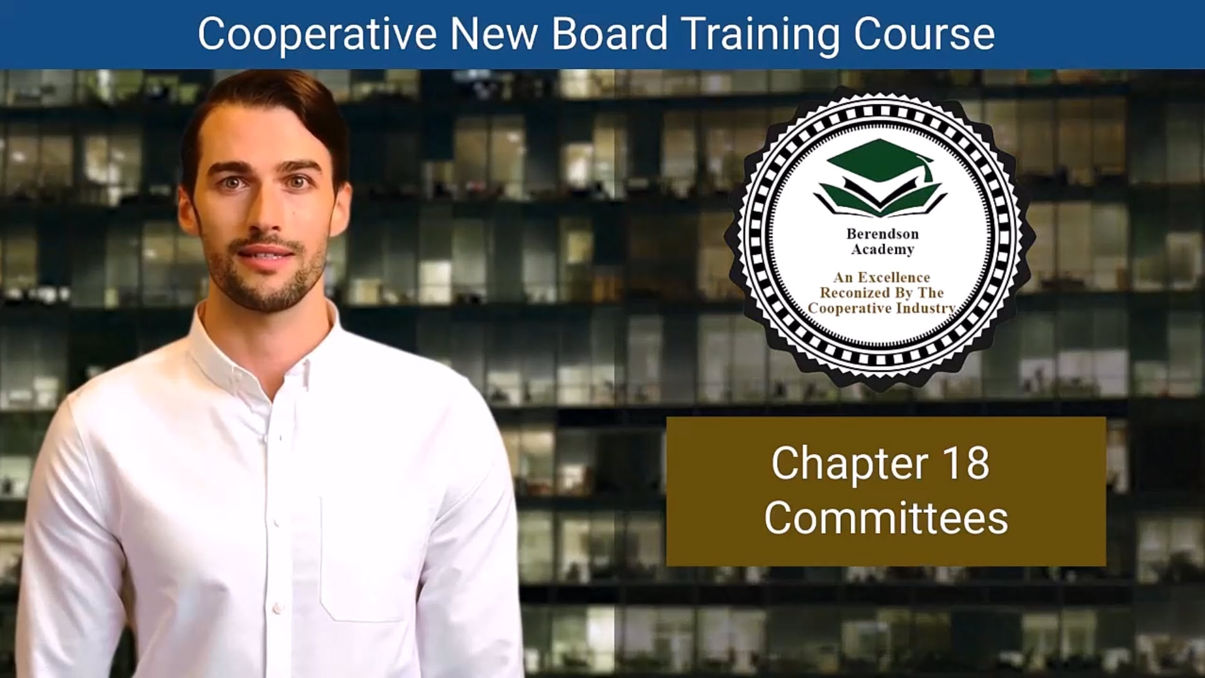

Slide 169
Chapter 18 The Power of Committees
Committees: The Heartbeat of a Strong Cooperative
Key Points:
  Committees transform ideas into action — they are where the cooperative’s mission becomes reality.
  They support the Board with expertise, research, and recommendations.
  Every committee functions under a clear charter or “Commission Statement.”
  They promote member engagement, leadership growth, and a stronger sense of community.

Slide 170
Committee Function and Structure
Blueprint for Effective Committees
Key Points:
  Committee Charter: Defines purpose, authority, goals, and meeting frequency.
  Size & Composition: Typically 4–6 members for optimal communication and efficiency.
  Term Limits: Encourage fresh perspectives while maintaining continuity.
  Member Requirements: Active, informed, and in good standing.
  Board Liaison Role: Acts as the bridge between committees and the Board — ensuring communication, alignment, and accountability.

Slide 171
Committee Charges and Accountability
Turning Direction into Action
Key Points:
  Committee Chairs appointed by the Board President with Board consent.
  Advisory Board Members provide oversight and connection.
  Decision-Making Process: Research → Discussion → Recommendation → Board Approval.
  Accountability:
    Attendance tracking
    Task completion monitoring
    Transparent reporting to the Board
  Ethical standards guide all discussions — no conflicts of interest or antitrust violations.

Slide 172
The Committee Liaison
Bridging the Gap Between Board and Committees
Key Points:
  The Liaison keeps communication flowing both ways.
  Attends committee meetings as a non-voting advisor.
  Ensures committee projects align with strategic goals.
  Communicates committee progress, challenges, and recommendations back to the Board.
  Helps resolve misunderstandings or overlaps between committees.

Slide 173
Building a Vibrant Cooperative
Committees in Action: Unity, Purpose, and Progress
Key Takeaways:
  Committees empower members to lead and serve together.
  Their work reflects the cooperative’s values of participation, education, and transparency.
  A strong committee culture builds stronger leadership, trust, and innovation.
  When committees thrive, the whole cooperative thrives.

Slide 174
1. Essence of Committees
Committees serve as the backbone of the cooperative, providing guidance and expertise to the Board of Directors. They play a crucial role in shaping the cooperative's future and implementing the board's decisions.
2. Establishing Committee Charters
Committees should have clearly defined charters that outline their purpose, powers, meeting frequency, and member responsibilities.
3. Optimal Committee Functioning:
Successful committees require clarity in objectives and timelines, appropriate size (typically 4-6 members), and term limits to prevent stagnation and promote fresh perspectives and diversity.
4. Role of Committees in Enhancing Community Vitality:
Proper maintenance is vital for preserving the cooperative's property value and ensuring a comfortable living environment. Members are encouraged to participate actively in maintenance and improvement initiatives.
5. Board Liaison Connection
Committees contribute to the cooperative’s success by providing expertise, developing educational programs, engaging members, and making recommendations to the board, all while acting in the best interests of the association.
6. Charges and Accountability
Clear expectations and responsibilities for committees are essential. Committees should operate under the guidance of the board, with accountability mechanisms in place

Slide 175
Chapter 18: Committees Quiz
What is the primary role of committees in a cooperative?
a) To oversee maintenance and repairs in the cooperative.
b) To make all final decisions regarding cooperative policies.
c) To provide guidance and expertise to the Board of Directors.
d) To handle all financial matters of the cooperative.
What is a Committee Commission Statement?
a) A statement outlining committee members' responsibilities.
b) A document defining the purpose, powers, and authority of a committee.
c) A list of committee members and their contact information.
d) A statement outlining the financial budget for a committee.
How does a cooperative typically determine the size of its committees?
a) Committees are always small, consisting of 2-3 members.
b) Committees are always large, consisting of 10 or more members.
c) Committees are sized based on the number of residents in the cooperative.
d) Committees aim for a balanced size, often consisting of 4-6 members.

Slide 176
Chapter 18: Committees Quiz
What is the primary role of committees in a cooperative?
a) To oversee maintenance and repairs in the cooperative.
b) To make all final decisions regarding cooperative policies.
c) To provide guidance and expertise to the Board of Directors.
d) To handle all financial matters of the cooperative.
What is a Committee Commission Statement?
a) A statement outlining committee members' responsibilities.
b) A document defining the purpose, powers, and authority of a committee.
c) A list of committee members and their contact information.
d) A statement outlining the financial budget for a committee.
How does a cooperative typically determine the size of its committees?
a) Committees are always small, consisting of 2-3 members.
b) Committees are always large, consisting of 10 or more members.
c) Committees are sized based on the number of residents in the cooperative.
d) Committees aim for a balanced size, often consisting of 4-6 members.

Slide 177


Slide 178
Chapter 19 Communication: The Heart of a Cooperative
Two-Way Communication Builds Stronger Communities
Key Ideas:
  Effective communication is the foundation of trust between the board and members.
  It’s a two-way flow — not just sending messages but listening and responding.
  Member feedback ensures leadership decisions reflect real needs.
  Communication strengthens engagement, transparency, and morale.

Slide 179
Cost-Effective and Cooperative Communication
Reaching Members Without Breaking the Budget
Key Ideas:
  Low-cost channels can have big impact:
    Bulletin boards, newsletters, and website updates.
    Announcements at meetings and word-of-mouth.
  Committees multiply communication power — membership, orientation, and newsletter teams keep everyone informed.
  The secret ingredient: enthusiasm and consistency, not money.

Slide 180
Essential Skills for Cooperative Leaders
Listening First, Leading Second
Key Ideas:
  Active listening is the board’s most vital communication skill.
  Core leadership skills for effective communication:
    Keep it business-focused, not personal.
    Understand finances to explain decisions clearly.
    Use professional email and written etiquette.
    Practice macro-management — focus on strategy.
    Stay patient and objective.
    Understand and respect staff roles.
  These skills build credibility, reduce conflict, and strengthen unity.

Slide 181
Crisis Communication: Staying Calm and Connected
When the Unexpected Happens
Key Ideas:
  Two types of crises:
    Emergencies — operational disruptions (e.g., storm, fire, loss of funding).
    Controversies — reputation or public-trust issues.
  The board’s job: lead ethically, legally, and consistently.
  Plan ahead with a Crisis Communication Plan:
    Defined roles, contact lists, and command structure.
    Designated spokesperson.
    Clear messaging and media strategy.
    Communication tree for rapid updates.

Slide 182
Building Trust Through Communication
From Everyday Updates to Emergency Response
Key Takeaways:
  Communication is the lifeblood of cooperation — every voice strengthens the mission.
  Listening and feedback build mutual respect and community pride.
  Committees and board members share responsibility for keeping members informed.
  Prepared communication — in calm or crisis — keeps the cooperative resilient and united.

Slide 183
1. Importance of Effective Communication
Effective communication is fundamental to the success of a cooperative, facilitating engagement, decision-making, and a strong connection between the board and its members.
2. Two-Way Flow of Information:
Communication should be a dynamic exchange between the board and members, emphasizing the need for feedback mechanisms to ensure that members' voices are heard, and their concerns are addressed.
3. Cost-Effective Communication Methods
Cooperatives can maintain effective communication without significant expenses by utilizing informal interactions, meetings, community bulletin boards, newsletters, and digital platforms to disseminate information and engage residents.
4. Role of Committees in Communication
Committees play a significant role in fostering communication within the cooperative by assisting in information dissemination, welcoming new members, and ensuring that community activities and news are effectively communicated.
5. Essential Skills for Board Members:
1. Committees play a significant role in fostering communication within the cooperative by assisting in information dissemination, welcoming new members, and ensuring that community activities and news are effectively communicated.
6. Crisis Communication Preparedness
Boards must be prepared for potential crises by developing effective crisis communication plans that address various scenarios, provide clear roles for board and staff, and ensure timely and transparent communication with stakeholders.

Slide 184
Chapter 19: Communication Quiz
What is the primary purpose of communication in a cooperative?
a) To convey board decisions to members.
b) To provide feedback from members to the board.
c) To maintain a strong connection with members through the exchange of information.
d) To increase the cost of communication methods.
What is the significance of a two-way flow of information in cooperative communication?
a) It ensures that all communication is controlled by the board.
b) It allows members to communicate with each other without board involvement.
c) It enables the board to communicate without member feedback.
d) It allows for member feedback and ensures that members' needs and concerns are addressed.
Which of the following is an example of a cost-effective communication method for cooperatives?
a) Hiring a public relations firm to handle communication.
b) Conducting large, expensive town hall meetings.
c) Sending personalized letters to each member.
d) Using community bulletin boards and informational newsletters.

Slide 185
Chapter 19: Communication Quiz
How can committees contribute to effective communication in a cooperative?
a) By handling all communication between the board and members.
b) By creating barriers to communication.
c) By assisting in conveying crucial information to members and welcoming new members.
d) By taking over the board's decision-making responsibilities.
Which of the following is considered the most essential skill for board members in terms of communication?
a) financial aptitude.
b) Micro-management of operational details.
c) Understanding that it's business, not personal.
d) Effective listening.

Slide 186
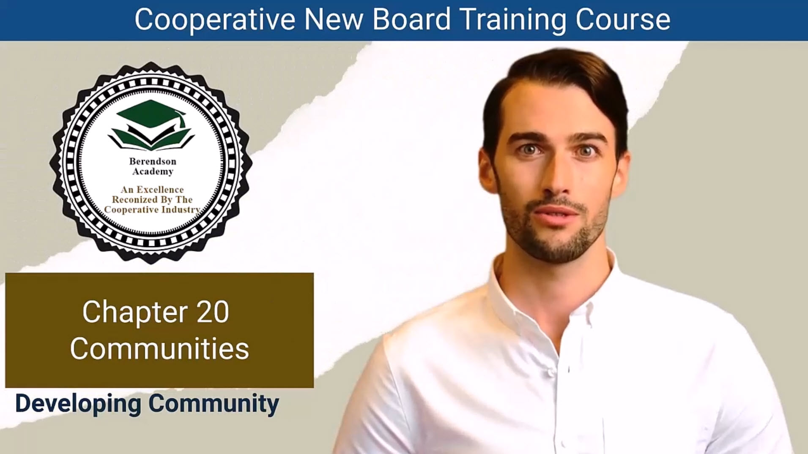

Slide 187
Chapter 20 Cooperatives: More Than Housing
Developing Community: The Heart of Cooperative Living
Key Points:
  Housing cooperatives go beyond affordability — they build connection, safety, and shared purpose.
  Members aren’t just residents; they are co-owners, decision-makers, and community builders.
  With over 1.5 million members nationwide, co-ops prove that collaboration creates stability and belonging.
  A well-functioning board and engaged membership form the backbone of every successful community.

Slide 188
Tools That Build Strong Communities
Practical Ways to Strengthen Connection
Key Points (condensed list of best practices):
  Board & Informational Meetings – transparency and engagement.
  Co-op Website & Apps – central hubs for communication.
  Newsletters – stories, updates, and education.
  Welcome Committees – personal outreach for new members.
  Social Events & Work Days – strengthen camaraderie and pride.
  Emergency Drills – build safety and teamwork.
  Member Orientation – instill cooperative values early.

Slide 189
Benefits That Extend Beyond the Co-op
How Cooperatives Strengthen Communities at Large
Key Points:
  Economic Growth: Co-ops help revitalize neighborhoods (e.g., St. Paul Art Crawl).
  Neighborhood Stability: They offer affordable options that resist gentrification pressures.
  Support for Seniors: Senior co-ops allow older adults to stay active in familiar communities.
  Financial Sustainability: Rising demand strengthens co-ops’ financial foundation.
  Social Capital: Trust and neighborly exchange grow naturally within cooperative systems.

Slide 190
Cooperative Members: Shared Rights & Responsibilities
Empowered Members Make Strong Communities
Key Points:
Members’ Rights:
  Fair treatment, safety, transparency, and a democratic voice.
  Members’ Responsibilities:
    Stay informed, participate in meetings, respect others, and pay on time.
  Mutual Trust = Stronger Communities
    Collaboration, empathy, and communication are the cornerstones of cooperative success.

Slide 191
Final Reflections & Continuing the Journey
Carrying the Cooperative Spirit Forward
Key Takeaways from the Course:
  Governance: Clear roles and ethical leadership sustain stability.
  Finance: Transparency, reserves, and accountability build trust.
  Legal & Maintenance: Compliance and care preserve the community.
  Communication: Listening connects people; clarity builds trust.
  Community Development: Shared values create belonging and pride.
  Continuous Learning: The best co-ops evolve — together.

Slide 192
Final Reflections & Continuing the Journey
Closing Message:
“You are now part of a proud tradition of cooperative leadership. Continue learning, mentoring others, and fostering communities that thrive through unity and compassion.”

Slide 193
1. Cooperative as a Community Model:
: Housing cooperatives are not just models of affordable living; they are vibrant communities where members actively engage and collaborate to create a strong sense of belonging
2. Building Strong Relationships:
Healthy relationships among members are essential for a thriving cooperative. Strong community ties enable members to work collaboratively, ensuring effective governance and enhancing the overall living experience.
3. Tools to Foster Community: Various
Various strategies can nurture community within housing cooperatives, including regular board and informational meetings, informative newsletters, welcome committees for new members, and social activities that promote engagement and interaction among residents.
4. Community Benefits:
Cooperatives contribute to broader community stability and growth, as demonstrated by efforts like revitalizing neighborhoods, providing affordable housing options, and combatting out-migration in rural areas through supportive environments for residents.
5. The Role of Members
Members are not only residents but active participants in shaping their communities, with both rights and responsibilities that contribute to the cooperative's mission and values.
6. Charges and Accountability
Members are not only residents but active participants in shaping their communities, with both rights and responsibilities that contribute to the cooperative's mission and values.

Slide 194
Chapter 20: Community Quiz
What is the central goal of housing cooperatives, beyond affordability?
a) To maximize profits for their members.
b) To create a sense of belonging and community.
c) To attract real estate investors.
d) To provide luxurious amenities.
What is the role of relationships among board members in fostering a positive atmosphere in a cooperative community?
a) Board members should avoid forming relationships to maintain impartiality.
b) Strong relationships among board members are not important.
c) Healthy relationships among board members contribute to a positive atmosphere.
d) Board members should only focus on relationships with residents.
Which of the following is considered a tool to foster community within housing cooperatives?
a) Outsourcing communication to a public relations firm.
b) Keeping board meetings exclusive to board members.
c) Using social media platforms exclusively for communication.
d) Creating an association website with member profiles and regular alerts.

Slide 195
Chapter 20: Community Quiz
How can cooperative housing contribute to personal safety within a community?
a) By implementing strict security measures.
b) By discouraging interactions among neighbors.
c) By fostering close-knit relationships and trust among neighbors.
d) By hiring security personnel.
What is one way that cooperatives stabilize neighborhoods facing gentrification?
a) By increasing housing prices to match the gentrification trend.
b) By providing affordable housing options, allowing lower-income families to stay.
c) By encouraging rapid development in the neighborhood.
d) By displacing existing residents to attract higher-income individuals.

Slide 196
By completing this course, you are well-equipped to contribute positively to your cooperative's success, whether you are a board member, officer, committee member, or dedicated member. Your knowledge and commitment to cooperative values will play a pivotal role in maintaining the cooperative spirit and thriving communities.

Slide 197

Questions?
More Information?

