Slide 1

Simplified Rules of Order for Meetings
A practical Guide for everyday Volunteers, Board Members, and Community Groups to run Smooth, fair and efficient meetings

Slide 2

Berendson Academy
Welcome to Berendson Academy
A free resource for cooperative housing education, offering tools, training, and support to help board members and residents succeed.
Our Vision
To build a future where cooperative housing is recognized as a sustainable and affordable model of living—supported by well-trained board members, empowered residents, and strong communities that thrive through shared knowledge and leadership.
Our Mission
To provide free, high-quality education, training, and resources that equip cooperative housing board members and residents with the knowledge, skills, and confidence to lead effectively, build strong communities, and sustain affordable housing for future generations.
WWW.BerendsonAcademy.com

Slide 3
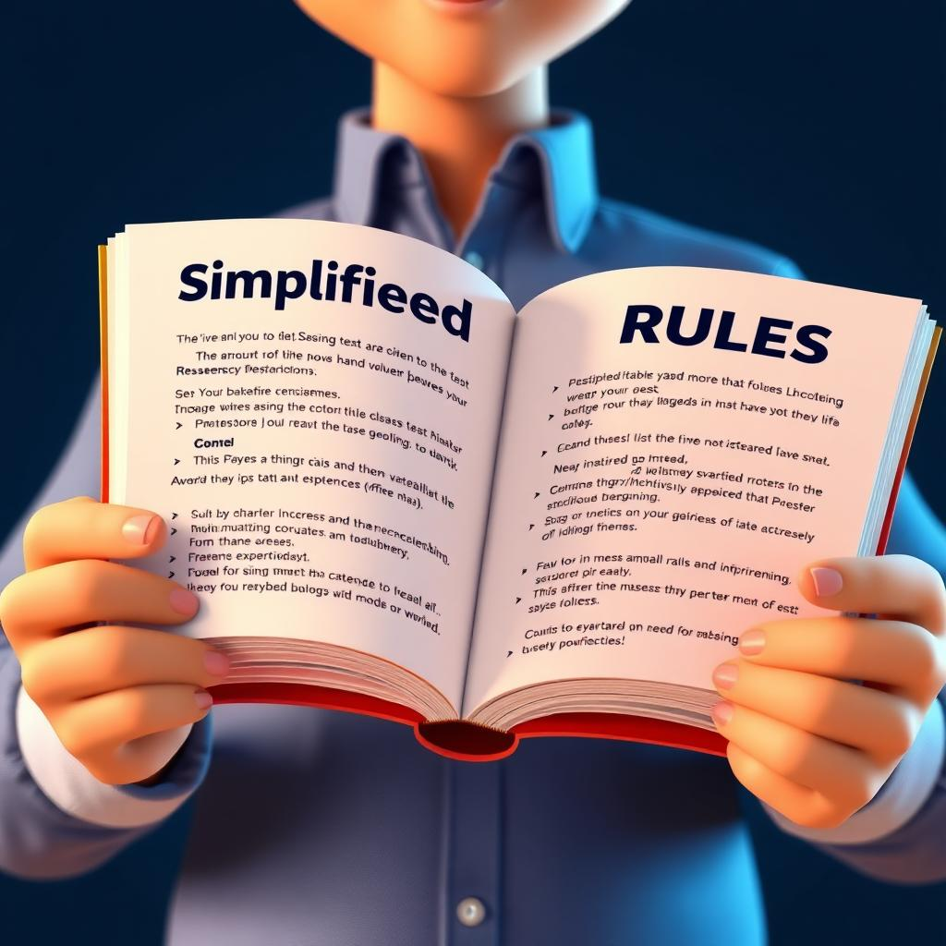
Guiding Principles of Meetings
These principles ensure meetings are fair and orderly, focusing on facilitating business without hindrance. They emphasize discussing one topic at a time to maintain focus.
Every member's rights are equal, with decisions made by majority while protecting minority opinions. Discussions precede voting for clarity and understanding.

Slide 4
Guiding Principles of Meeting Conduct
Rules should facilitate business by maintaining order and focus. Discussing one topic at a time ensures clarity and prevents confusion.
All members have equal rights to participate, ensuring fairness and inclusivity. Decisions are made through majority voting to reflect democratic values.
Minority views are respected, safeguarding diverse perspectives and enhancing decision-making.
Discussion before voting ensures all members are informed, promoting transparent and informed decisions.

Slide 5

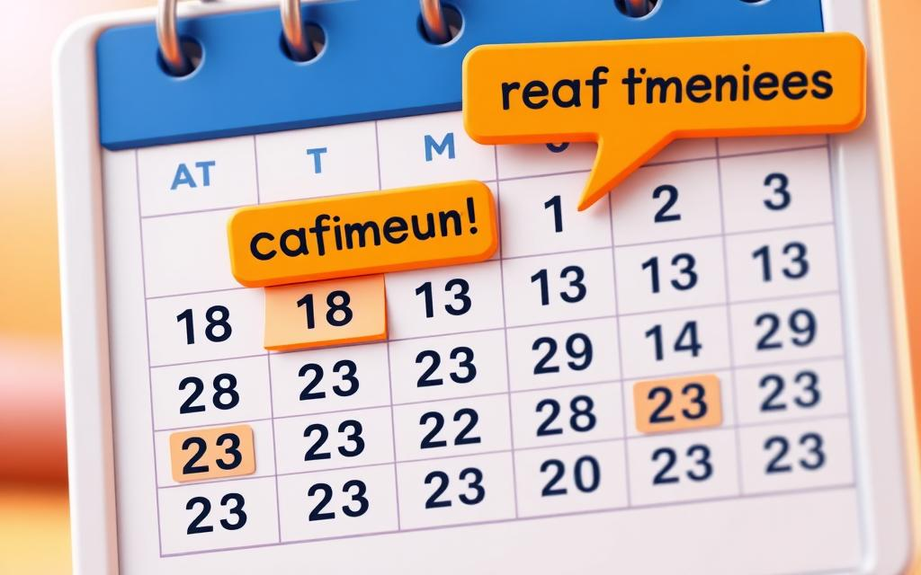

Effective Meeting Preparation Steps
Select a Suitable Venue
Choose a venue with adequate seating and good acoustics to ensure all participants can engage and hear clearly, enhancing the overall meeting experience.
Confirm Key Participants
Ensure the availability of essential participants. Confirm their attendance ahead of the meeting to avoid last-minute scheduling conflicts.
Distribute Materials in Advance
Share agendas and reports prior to the meeting. This helps participants prepare, thereby improving the quality and efficiency of discussions.

Slide 6



Essential Quorum Guidelines for Meetings
Defining a Quorum
Consequences of Lacking Quorum
Restoring Quorum During Sessions
A quorum is the minimum number of members needed for a meeting to conduct official business effectively.
Without a quorum, votes are invalid, but meetings can still be opened and adjourned for procedural purposes.
If a quorum is lost, new votes must be postponed until the quorum is re-established to maintain order.

Slide 7
The Importance of Agenda
Drafting the Agenda
Drafted by the chair or secretary, the agenda can be amended by members, ensuring it covers all necessary topics for an efficient meeting.
Plan for Success
Preventing Surprise Topics
An agenda helps prevent unexpected topics, keeping discussions organized and focused, thus enhancing meeting productivity.
  Time Management Benefits
A well-structured agenda allows for better time management by allocating specific times for each topic, ensuring meetings run smoothly.

Slide 8
Motions are essential for structured decision-making in meetings, guiding the process through formal proposals.
A motion must be made, seconded, and clearly stated by the chair to ensure clarity and understanding among members.
Members engage in discussion on the motion before proceeding to a vote, ensuring all perspectives are considered.
Various voting methods, including voice, show of hands, and ballot votes, provide flexibility and inclusivity in decision-making.
Conducting Business Through Motions

Slide 9

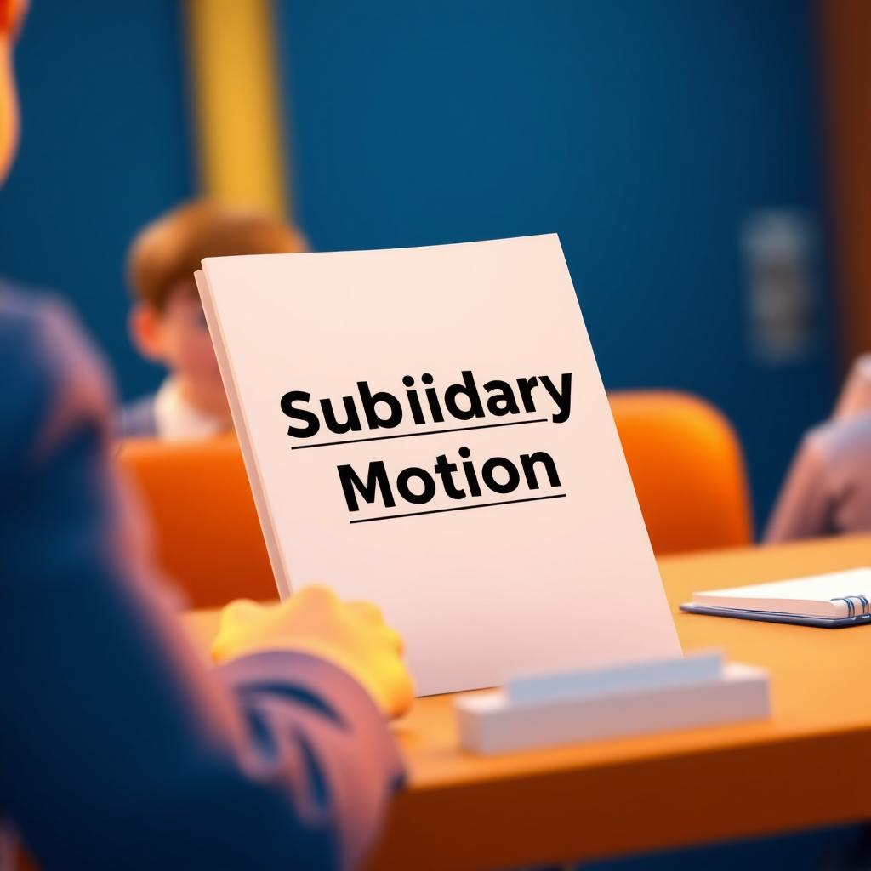



Understanding Motion Categories
Types of Motions
Main
Motions
Subsidiary Motions
Privileged Motions
Incidental Motions
Revisiting Motions
Introduce new business and require a majority vote for approval.
Help manage or modify main motions, taking precedence over them.
Address urgent matters, taking priority over other types of motions.
Deal with procedural issues, requiring immediate resolution.
Allow changing or correcting previous decisions as needed.

Slide 10

Effective Voting Procedures in Meetings
COMMON VOTING METHODS
MAJORITY AND TWO-THIRDS VOTES
ANNOUNCING AND RECORDING RESULTS
Standard methods include voice votes, show of hands, and ballot votes for clarity and accuracy.
Majority votes decide most motions, while two-thirds votes are needed for certain actions.
The chair announces results clearly and ensures they are accurately recorded in the minutes.

Slide 11


Key Terms and Definitions
Understanding Key Concepts
Motion
Quorum
A proposal for action in a meeting.
Minimum members needed for a valid meeting.
Agenda
Second
A list of items to be discussed in a meeting.
A demonstration of support for a motion.

Slide 12

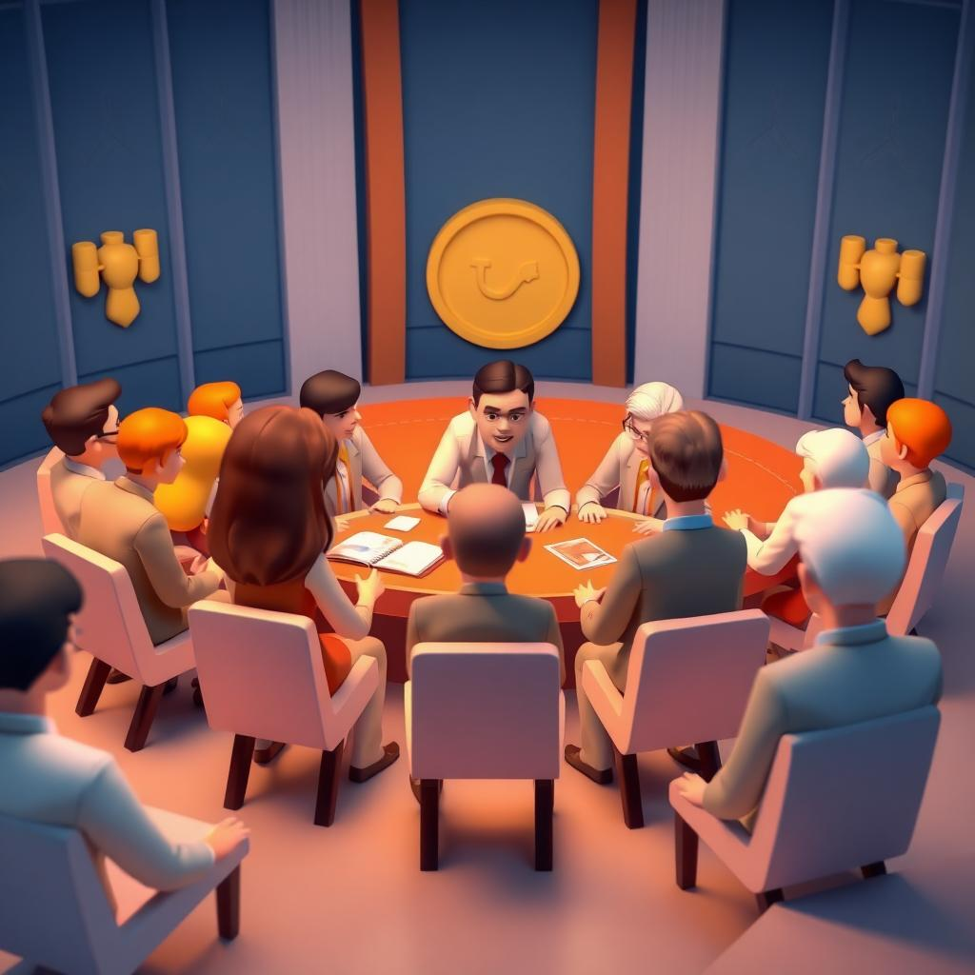

Special Procedures
in Meetings
Handling Special Cases
Appeals allow challenging chair decisions.
Committees of the Whole enable in-depth discussion.
Minority rights ensure all voices are heard.

Slide 13

Effective Meeting Management Tips
Begin and end meetings on time, sticking to the agenda for efficient timing.
Encourage open participation and respectfully manage conflicts among attendees.
Summarize decisions clearly and document them accurately in the minutes.

Slide 14

Running Effective Meetings
Tips for Smooth Operations
Begin and conclude on time, adhering strictly to the agenda.
Foster open participation and handle conflicts with respect.
Summarize key decisions and record them accurately.

Slide 15


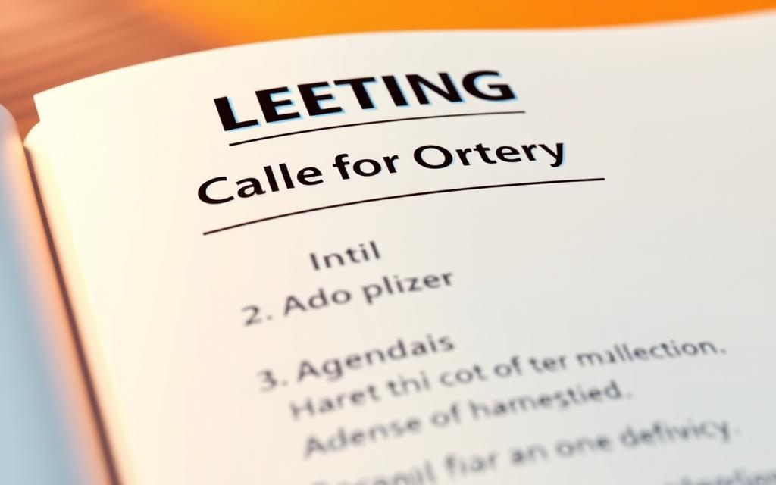
Tips for Running Effective Meetings
Time Management and Agenda Adherence
Ensure meetings start and end on time by following the set agenda, which helps maintain focus and ensures all topics are adequately covered.
Fostering Participation and Managing Conflicts
Encourage active participation by all members and handle any conflicts respectfully to create a productive and collaborative environment.
Decision Summarization and Accurate Recording
Summarize all key decisions made during the meeting and record them accurately in the minutes to ensure clarity and accountability.

Slide 16
Understanding Parliamentary Procedure
Informal Consideration
Debate
Allows open discussion without formal rules.
Refers to the discussion on a motion.
Division
Obtaining the Floor
Voting where members stand to show support.
Grants a member the right to speak.
Parliamentary Inquiry
Motions
Checks the proper course of procedure.
Formal proposals that guide meeting actions.

Slide 17
Types of Motions and Their Functions
Incidental Motions
Privileged Motions
Present independent ideas for consideration; require a majority vote to pass.
Help manage, modify, or postpone a main motion to clarify or refine the discussion.
Address procedural questions; must be resolved before attending to main motions.
Take precedence due to urgent nature; can interrupt routine business to be addressed.
Main Motions
Subsidiary Motions

Slide 18
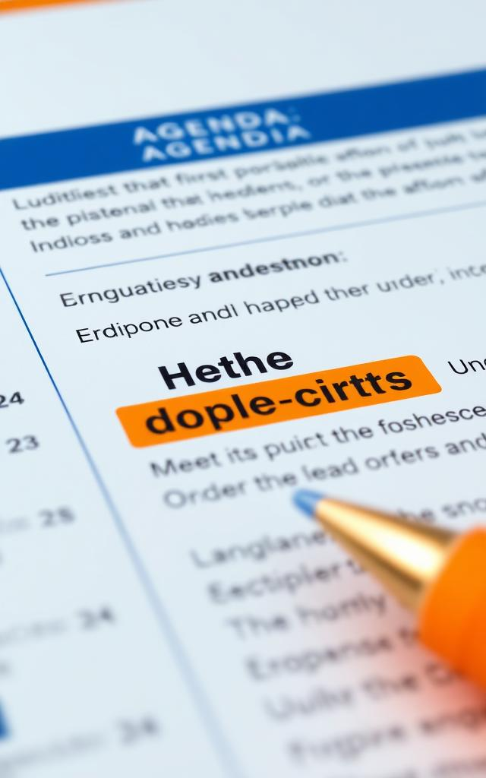
Understanding Rules and Orders
in Meetings
A
General orders schedule future discussions, maintaining agenda integrity.
B
Special orders enable rule suspension for specific issues, ensuring flexibility.
C
Orders of the day ensure adherence to the agenda, maintaining meeting focus.
D
Indefinite postponement rejects a motion, effectively putting it aside.
E
Previous question motions demand a vote, ending debates immediately.

Slide 19

Importance of Robert's Rules
Orderly Decision-Making
Protecting Member Rights
Ensures decisions are orderly, compliant, and fair.
Safeguards member rights to inform, discuss, and vote.
Effective Meetings
Agenda Adherence
Debate limits and respect enhance meeting effectiveness.
A published agenda keeps meetings productive and on track.

Slide 20

Table Motion
Previous Question
Delays action to prioritize urgent business needs.
Ends debate and secures an immediate vote on the issue.
Common Motions
in Meetings
Limit Debate
Postpone Definitely
Frequently used motions and their effects.
Controls the duration and frequency of discussions.
Allows for more informal discussion before a decision is made.
Amend Motion
Improves the wording or intent of the original motion.

Slide 21



Meeting Prep & Follow-Up
Checklist for Success
Before: Set agenda, confirm logistics, prepare materials.
During: Greet attendees, manage time, ensure participation.
After: Share documents, send thank-yous, review feedback.

Slide 22
Berendson Academy
Welcome to Berendson Academy
A free resource for cooperative housing education, offering tools, training, and support to help board members and residents succeed.
Our Vision
To build a future where cooperative housing is recognized as a sustainable and affordable model of living—supported by well-trained board members, empowered residents, and strong communities that thrive through shared knowledge and leadership.
Our Mission
To provide free, high-quality education, training, and resources that equip cooperative housing board members and residents with the knowledge, skills, and confidence to lead effectively, build strong communities, and sustain affordable housing for future generations.
WWW.BerendsonAcademy.com

Slide 23

Simplified Rules of Order
A Guide for Conducting Fair and Efficient Meetings

